Slide 1
NG911 GIS User Group
2020 Q2 Meeting
June 4, 2020
https://kansas.zoom.us/j/95279773680
Meeting ID: 952 7977 3680 Password: 393705

Slide 2
Agenda
Project Update
ESB alignment and Geospatial Call Routing
NG911 Toolbox Update
Events and Outreach

Slide 3
NG911 Project Update
Reminder - 2020 Q2 GIS data submission deadline – June 30, 2020
NG911 Imagery
2021 Imagery refresh
Requesting approval from 911 Coordinating Council to move forward with RFP
local imagery buy-up
Statewide composite Kansas geocoder service available in DASC data catalog
Cascade order:
Kansas NG911 Address Points
Kansas NG911 Road Centerline
Kansas local address points
US Census Bureau TIGER 2010 Roads

Slide 4
NG911 Project Update
Cloud based mapping software – RapidDeploy’s Radius Plus
replaces existing KS NG911 call handling map software Vesta Locate
Architecture & Data
DASC hosts statewide custom map, image and web map services using Kansas authoritative data
Your data submissions update these services weekly
Parcels – update and submit through NG911 portal or PORKA
Recently added KCC electric service boundaries to Radius Plus web map
Data is also available for download from DASC data catalog
Installation Status
Temporarily paused due to COVID-19
If proceed on schedule without further interruption, then fully installed across hosted solution in early August

Slide 5
NG911 Project Update
Kansas GIS Services Configuration to support Kansas Hosted Solution deployment of RapidDeploy’s Radius Plus
Web Map Radius BASEMAP tab (all on/off) | Map Services Radius ESRI tab (on/off by layer) | Kansas Geocoding Service - primary cascading location service
Hosted Address Points (primary & secondary) | NonHosted Address Points (primary & secondary) | Statewide address points (primary)
Hosted Roads | NonHosted Roads | Statewide roads
Hosted Law/Fire/EMS/Rescue/FireAutoAid | NonHosted Law/Fire/EMS/Rescue/FireAutoAid | Statewide MSAG Communities
Hosted Fire Hydrants | NonHosted Utility Boundaries
Hosted Gates | Parcel Property Boundaries
Hosted Bridges | KDOT HWY Mile Markers
Hosted Utility Boundaries
2018 NG911 Imagery
Statewide County Boundaries
Statewide Municipal Boundaries
Statewide streams/rivers
Statewide water bodies
Statewide Highways & HWY symbols
KDOT Railroads and crossings

Slide 6
NG911 Project Update
Kansas GIS Services in Radius Plus

Slide 7
NG911 Project Update
Kansas GIS Services in Radius Plus

Slide 8
NG911 Project Update
Kansas GIS Services in Radius Plus

Slide 9
GeoMSAG and Geospatial Call Routing Update

Slide 10
News Items
All PSAPs on the Hosted Solution have converted to geoMSAGs
Geospatial call routing is being implemented around the state and scheduled for completion in August.
As of this morning, 51 PSAPs are routing solely via GIS data

Slide 11
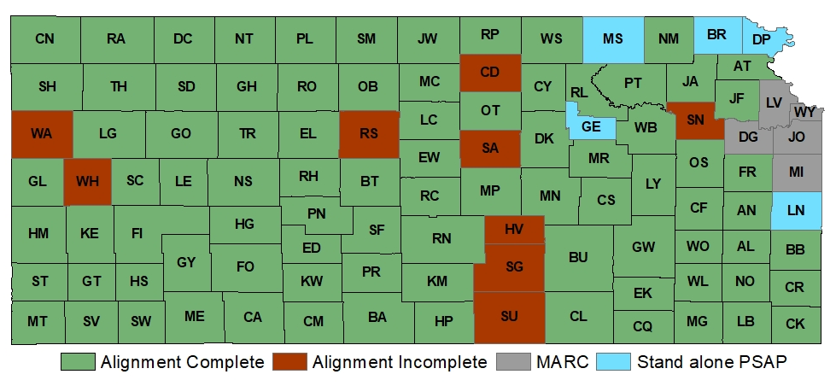
ESB Alignment Status

Slide 12
Going Geospatial – GIS impacts
PSAPs using geospatial call routing are using the ESB layers instead of ESNs and ELTs. ESNs will still need to be maintained as they are the backup system for routing failures
ESB DISPLAY field has a reduced character limit. While it is 60 characters in the NENA standard and the Kansas standard, the phone software in the PSAP is limited to the first 32 characters in the field. The toolbox gives a notice on this
Alignment must be complete and submitted for any of this to display
Questions about alignment?

Slide 13
Getting data in the geoMSAG takes a bit
You submit the change to the Portal
All data in the portal is submitted to Intrado the next Tuesday, but we can do an extra submission if you need it faster, just ask.
Once we submit to Intrado, it takes 1-4 business days before it shows up in the geoMSAG for the phone company to use.

Slide 14
NG911 Toolbox Update
Kristen Jordan Koenig

Slide 15
New Version- April 2020
Toolbox update sent out last month
Not many updates for core toolbox
Additional error trapping
PSAP boundary update

Slide 16
Future
Please get ESB alignment in if you haven’t already
Toolbox will occasionally have PSAP boundary updates

Slide 17
Events & Outreach
State to State collaboration:
Oklahoma NG911 –Kansas NG911 Portal
Tennessee – geoMSAGs, EGDMS and ESBs
North Central Texas – Kansas RapidDeploy architecture
Arkansas NG911 GIS meeting – POSTPONED
Cancelled Events
Kansas APCO (Association of Public-Safety Communications Officials) Spring Conference
MAGIC 2020
NG911 GIS Data Steward & Data Maintainer In-Person Certification Classes

Slide 18
NG911 GIS User Group
Thank you!
Kansas 911 Coordinating Council website
http://www.kansas911.org/
DASC - Initiatives>NG911
http://www.kansasgis.org/initiatives/NG911/

