Slide 1
NG911 GIS User Group
2019 Q1 Meeting
February 21, 2019
https://kansas.zoom.us/j/985531339 1 646 876 9923
Meeting ID: 985 531 339

Slide 2
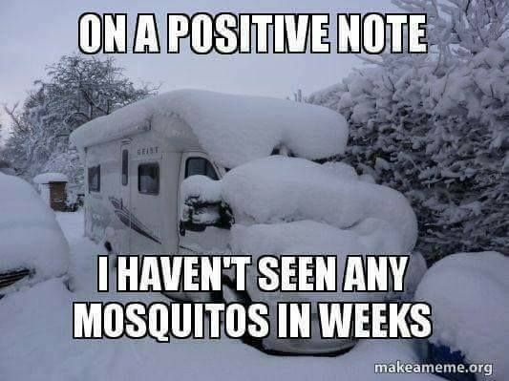
Weather update

Slide 3
Agenda
Project & Imagery Update
GeoMSAG and Geospatial Call Routing Update
NG911 Toolbox Update
Resources

Slide 4
NG911 Project Update
As of today - 93 PSAPs (including 3 backup centers) on the Kansas 911 Coordinating Council’s hosted system
PSAPs are using current & authoritative data daily
85 PSAPs now operating off a geoMSAG
70 PSAPs cut over to AT&T’s nationwide Emergency Services IP Network (ESInet)

Slide 5
NG911 Imagery Update
Imagery QA completed by 12/31/18 thanks to our volunteers
Statewide 1’ resolution, leaf off, color imagery
Surdex is currently reviewing and reprocessing error calls
*Imagery should be available this spring*
Imagery formats:
MrSID - USGS 24K tiles - Stateplane N/S
GeoTIFF – USGS 24K quarter, quarter tiles – Stateplane N/S
Valtus password protected image service
Valtus image server username and passwords will remain the same, no changes

Slide 6
NG911 Imagery Update
Licensing:
According to the 2018 NG911 Imagery Contract’s End User License Agreement (EULA), the following entities are approved users and shall be allowed unlimited access licenses:
All State of Kansas Government Agencies and Regents-level institutions
All Kansas County-level governments
All Kansas Municipal (city) governments
All Kansas Public Safety Answering Points (PSAP)
All Kansas Public School Districts
Any commercial firm or organization doing work on behalf of one of the entities listed above.
Additionally, license agreement shall allow;
Approved users to develop and publish publically-available web applications which utilize ortho-imagery or web map services
Approved users to print and distribute hardcopy format maps that display the ortho-imagery or web map service

Slide 7
NG911 Imagery Update
Distribution:
DASC will send out a notification with instructions on how to download the imagery to NG911 GIS Data Stewards, NG911 GIS Data Maintainers and County Appraiser offices
Do NOT share credentials outside of your organization
If anyone outside of your organization asks how to get a copy of the imagery, please direct them to the DASC data request page

Slide 8
NG911 Imagery Update
Local Imagery Buy Up
Still available for 2019 flying season
For more information and pricing
contact Tim Donze, Surdex - TimD@SURDEX.COM
DASC will be contacting the local buy up jurisdictions for permission to obtain a copy of your imagery for NG911 purposes

Slide 9
Next Generation 911
House Bill 2084
House Committee on Energy, Utilities & Telecommunications Hearing on 2/5/19
What are some of the changes proposed in HB2084?
Increase fee from $.60 to $1.03 monthly to sustain 911 service and fund future enhancements
$.80 to PSAPs
$.23 to deployment and sustainment
Provides the authority to ensure GIS data integrity
Ensures continuation of 2011 Kansas 911 Act legislative mission of migrating Kansas to full NG911 capability
Changes a 911 Coordinating Council position appointment to represent Kansas Chapter of the Assoc of Public Safety Communications Officials
Add two non-voting members who must represent non-traditional PSAPs

Slide 10
GeoMSAG and Geospatial Call Routing Update

Slide 11
News Items
Eighty-five PSAPs have switched out their MSAGs for geoMSAGs
We will be asking for a contact to receive error notifications on GIS data submissions. If we do not get one, we will have those notifications sent to the GIS Data Maintainer.
Lunch and Learn on NG911 routing issues on February 28th. Not GIS specific, but useful if you use 911Net or GIS Director.

Slide 12
Going Geospatial
Reno County will transition to geospatial call routing next week, and after a successful 30-day test period other PSAPs will start the transition
PSAPs using geospatial call routing will start using the ESB layers instead of ESNs and ELTs. ESNs will still need to be maintained as they are the backup system for routing failures
ESB DISPLAY field has a reduced character limit. While it is 60 characters in the NENA standard and the Kansas standard, the phone software in the PSAP is limited to the first 32 characters in the field.

Slide 13
Unmatched TNs
TNs that did not match GIS data when the geoMSAG was created are still in the 911 database, but they are in a special error status
The address information displays for dispatchers, but they do NOT route properly.
A list of them was sent to Data Maintainers right after each geoMSAG conversion, and many people got them all fixed.
If your county has any remaining, you’ll be getting a new list of them shortly. Please plan to work on them as soon as possible.

Slide 14
ESB/Polygon Topology
No gaps, overlaps
Will be “errors” for the June 2019 submission

Slide 15
From afar, so pretty

Slide 16
But, it has issues

Slide 17
But wait, there’s more

Slide 18
After running toolbox…

Slide 19
In ArcMap
Bring in Topology & ESB layer(s)
Activate Topology toolbar
Start an edit session

Slide 20
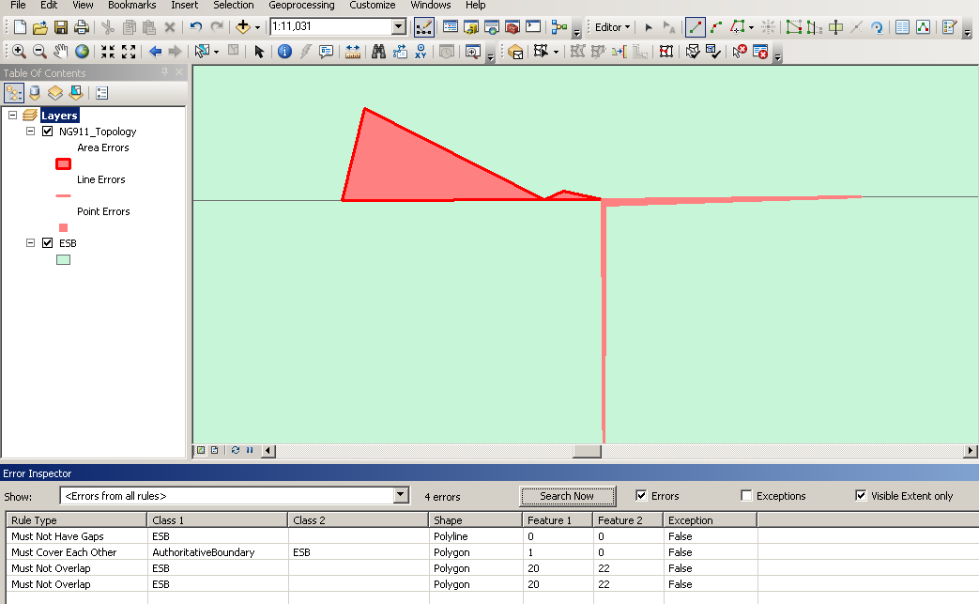
How it looks

Slide 21
How to fix
Make sure vertices match up EXACTLY between features
You can always run topology in ArcMap again and again
Beware validating full extent vs current extent
Error inspector is helpful

Slide 22
How to fix the “gap” on the county boundary
Mark it as an exception in an edit session in ArcMap

Slide 23
NG911 Toolbox Update
Kristen Jordan Koenig

Slide 24
New Version- Late January 2019
New Enhancement Tools
Road ESN checker- validates road ESN values against ESZ boundaries
Add/Verify Topology- makes sure topology rules are all the correct ones, fixes if necessary

Slide 25
Other improvements
Fixed Check Layer List- required ESB naming convention
Address points marked GEOMSAG = Y not duplicated in roads
Improved Add KSPID tool
Edited NGKSPID check for parcels
Fixed random lyr error in Topology check

Slide 26
Looking Ahead
Polygon topology “notices” will become “errors”
Other developments depend on…
West’s data testing
Bug reports

Slide 27
Resources
NG911 Portal:
GIS Frequently Asked Questions (FAQs)
Archive of NG911 GIS questions and answers
Submit a new question anytime!
DASC website
https://www.kansasgis.org>Initiatives>Next Generation 911 (NG911)
Standards, Tools & Policies tab
Kansas NG911 GIS Post Processing Steps
Vesta Locate and Statewide Layers updates
EGDMS (Enterprise Geospatial Database Management)
PSAP data layer
2019 NG911 GIS Data Steward and GIS Data Maintainer certification classes
Dates TBD

Slide 28
NG911 GIS User Group
Thank you!
Kansas 911 Coordinating Council website
http://www.kansas911.org/
DASC - Initiatives>NG911
http://www.kansasgis.org/initiatives/NG911/

