Slide 1
NG911 GIS User Group
2018 Q4 Meeting
October 19, 2018
Kansas Association of Mappers (KAM) Annual Conference

Slide 2
Agenda
Project Update
GeoMSAG and Geospatial Call Routing Update
NG911 Toolbox Update

Slide 3
NG911 Project Update
88 PSAP’s now live on the 911 Council’s hosted system…using current & authoritative data
41 PSAPs cut over to AT&T’s nationwide Emergency Services IP Network (ESInet)
47 PSAPs now operating off a geoMSAG
Full i3 Geospatial Call Routing will be available after
PSAP has transitioned to a geoMSAG
PSAP ESB topology is clean (no gaps or overlaps)
Required call handling software upgrade (currently being tested by ATT labs) has been released and installed

Slide 4
Kansas NG911 GIS Data submission & post processing
PSAP
Vesta Locate
PSAP A
Kansas
NG911 Portal
EGDMS
PSAP B
Quarterly updated data
Automated data validation and aggregation
PSAP C
Master Repository

Slide 5
NG911 Imagery Update
QA/QC underway:
Surdex’s SurCheck QA/QC imagery review tool
We need your help with the imagery QA!
Ask Kristen how to sign up
Training:
SurCheck training video
Surdex PDF training guide
http://arcg.is/14CGnr

Slide 6
NG911 Imagery Update
When can I get the imagery???
Complete QA/QC
Corrections and processing
Available in MrSID Gen 4 format, 24K quad tiles
Request on DASC website
Licensed imagery

Slide 7
GeoMSAG and Geospatial Call Routing Update

Slide 8
News Items
GeoMSAGs conversions this week:
Allen, Bourbon, Labette, and Coffeyville
GIS Director training
Duplicate address point test has changed to match West, so it only includes address and MSAG Community.

Slide 9
What to expect from the geoMSAG process
Possible questions about ESNs to help organize the move to the ESINet
PSAP review of the responders for ALI display
NG911 Portal ESN/Responder review map
Notification one week ahead that your GIS data is about to be pulled so you can submit any last minute edits
After the conversion, you’ll get the errored TNs. They will no longer be visible to you anywhere but that error list.
All edits after the switch must be made through GIS data

Slide 10
ESB/Polygon Topology
No gaps, overlaps

Slide 11
From afar, so pretty

Slide 12
But, it has issues

Slide 13
But wait, there’s more

Slide 14
Pause
At this point in making the presentation, Kristen discovered multiple major code errors
And they are fixed now
No one probably ever got topology errors with the toolbox
Sorry for the false positives

Slide 15
After running toolbox…

Slide 16
In ArcMap
Bring in Topology & ESB layer(s)
Activate Topology toolbar
Start an edit session

Slide 17
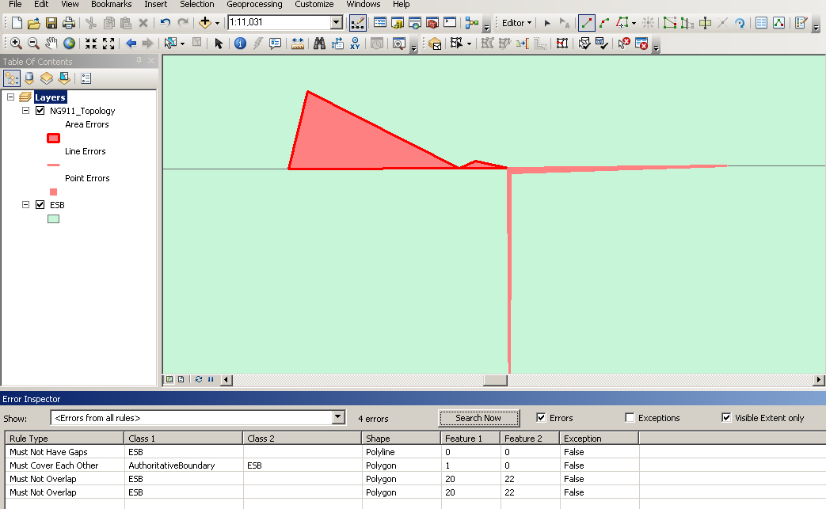
How it looks

Slide 18
How to fix
Make sure vertices match up EXACTLY between features
You can always run topology in ArcMap again and again
Beware validating full extent vs current extent
Error inspector is helpful

Slide 19
NG911 Toolbox Update
Kristen Jordan Koenig

Slide 20
New Version- Monday (10/15/18)
Polygon topology check in validation, actually works now

Slide 21
Other improvements
Fixed parcel import
Fixed road lock error
Fixed TN issues

Slide 22
Looking Ahead
Depends on…
West’s data testing
Bug reports

Slide 23
NG911 GIS User Group
Thank you!
Kansas 911 Coordinating Council website
http://www.kansas911.org/
DASC - Initiatives>NG911
http://www.kansasgis.org/initiatives/NG911/

