Slide 1
NG911 GIS User Group
2018 Q3 Meeting
August 27, 2018
https://kansas.zoom.us/j/392999748 Dial In: 646 876 9923
Meeting ID: 392 999 748

Slide 2
Agenda
Project Update
GeoMSAG and Geospatial Call Routing Update
NG911 Toolbox Update
Future events

Slide 3
NG911 Project Update
2018 Q2 submission – 100% participation
101 counties submitted updates
4 counties verified no changes

Slide 4
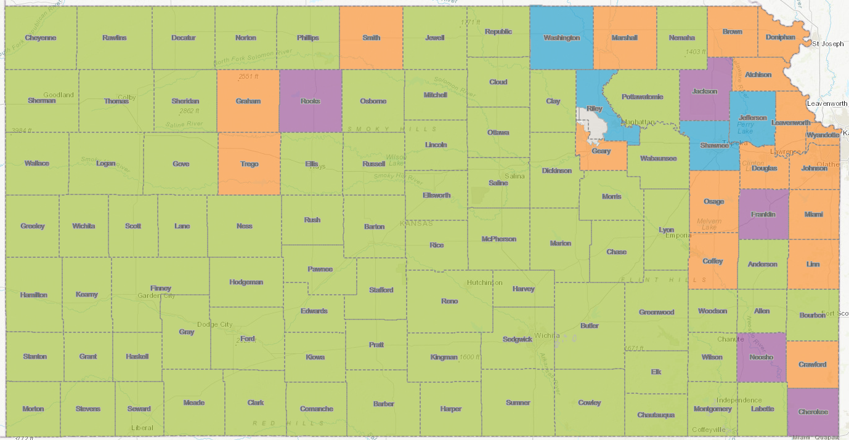
NG911 Project Update
85 PSAPs now on the hosted solution

Slide 5
NG911 Project Update
Hosted Solution Mapping software
Vesta Locate - current mapping software used by call handlers in State Hosted solution
July, 2017 End of Life Announcement
Vesta Map Local - new software, evaluating software along with system requirements, timeline etc.
Phase 1 – internal evaluation of Vesta Map Local at Yoder backup site (July)
Phase 2 – Kansas team and project partners meeting and full evaluation at Yoder backup site (Sept)
No change in NG911 GIS data submission process

Slide 6
NG911 Project Update
ESInet – Emergency Services IP Network
Transition to geoMSAGs completed for 24 PSAPs
24 PSAPs have migrated to ESInet (Emergency Services IP Network)
Full i3 Geospatial Call Routing will be available after
PSAP has transitioned to a geoMSAG
PSAP ESB topology is clean (no gaps or overlaps)
Required call handling software upgrade (currently being tested by ATT labs) has been released and installed

Slide 7
NG911 Imagery Update
Current activity:
SurCheck QA/QC (Surdex imagery review tool)
State divided into 3 regions, then subdivided into zones and tiles for review
West region currently available for QA, Central mid-September, East early October
SurCheck is easy to use and web based - no special software or installation required
We need your help with the imagery QA!
NG911 Imagery QA/QC Sign Up email sent to NG911 GIS Data Maintainers today through NG911 Portal
Please sign up using link in email
If you didn’t receive the email and would like to help with the imagery QA, contact Kristen
Kristen created a SurCheck training video and Surdex has provided a PDF training guide

Slide 8
NG911 Imagery Update
When will the imagery be available?
After QA wraps up, Surdex will need time for final data processing and delivery
Announcements will be sent out when imagery is available
Imagery will be available by request on DASC website
High-resolution buy up program
All buy-up projects will be designed and estimated based on the needs of each organization
Agreements between jurisdiction and Surdex
Available throughout 3 year contract
Tim Donze - TimD@SURDEX.COM

Slide 9
GeoMSAG and Geospatial Call Routing Update

Slide 10
News Items
Twenty-four PSAPs have switched out their MSAGs for geoMSAGs
The next to convert are: Morton, Stanton, Butler, Augusta, Andover, McPherson, Harvey, Cowley, Marion, Chase, Lyon, Greenwood, Elk, Chautauqua, Montgomery, Wilson, Woodson, Allen, Labette, Bourbon
First GIS Director training is tomorrow. It will be repeated every few months as the process progresses
Duplicate address point test has changed to match West, so it only includes address and MSAG Community.

Slide 11
What to expect from the geoMSAG process
Possible questions about ESNs to help organize the move to the ESINet
PSAP review of the responders for ALI display
Notification one week ahead that your GIS data is about to be pulled so you can submit any last minute edits
After the conversion, you’ll get the errored TNs. They will no longer be visible to you anywhere but that error list.
All edits after the switch must be made through GIS data

Slide 12
Things we’ve learned so far
If you don’t have 100% alignment before you switch, you’ll have to get there after you switch
Comprehension and Communication are key
If your GIS data is correct, you probably won’t have much to manage

Slide 13
NG911 Toolbox Update
Kristen Jordan Koenig

Slide 14
New Version- Last Week
Removed MUNI & ZIP from the address point frequency test so errors match West’s testing
Included polygon topology check in validation, notice

Slide 15
Other improvements
Sped up some tests
Fixed issue with data comparison tool
Fixed various TN road name issues

Slide 16
Looking Ahead
Depends on…
West’s data testing
Bug reports

Slide 17
NG911 Portal
No major updates effecting GIS submissions
ELT or ESN/Responder name and area interactive review map on NG911 Portal
Review of ELT names coming from ATT legacy database
Fire, Law and EMS names that appear in call handler ALI feed
Only effects PSAPs migrated or migrating soon to ESInet during transition phase
Review needs to be done by the PSAP Operations Manager or PSAP GIS Data Steward, not the GIS Maintainer

Slide 18
NG911 GIS User Group
NG911 GIS Data Steward Certification Class
Kansas APCO Conference, October 8 - Salina
NG911 GIS Data Maintainer Certification Class
KAM Conference, October 16 – Manhattan
Conference registration not required
KAM Conference, Oct 17-19 – Manhattan
2018 Q4 NG911 GIS User Group
Behind-the-Scenes of the NG911 Toolbox session

Slide 19
NG911 GIS User Group
Thank you!
Kansas 911 Coordinating Council website
http://www.kansas911.org/
DASC - Initiatives>NG911
http://www.kansasgis.org/initiatives/NG911/

