Slide 1
NG911 GIS User Group
2018 Q2 Meeting
May 24, 2018
https://kansas.zoom.us/j/350981677 1 669 900 6833
Meeting ID: 350 981 677

Slide 2
Agenda
Project Update
Preparing GIS Data for Geospatial Call Routing
NG911 Toolbox Update
Future events

Slide 3
NG911 Project Update
2018 Q1 submission – 100% participation
99 counties submitted updates
6 counties verified no changes
Kansas NG911 GIS Data Model v2.1
Q2 - June 30, 2018 deadline

Slide 4
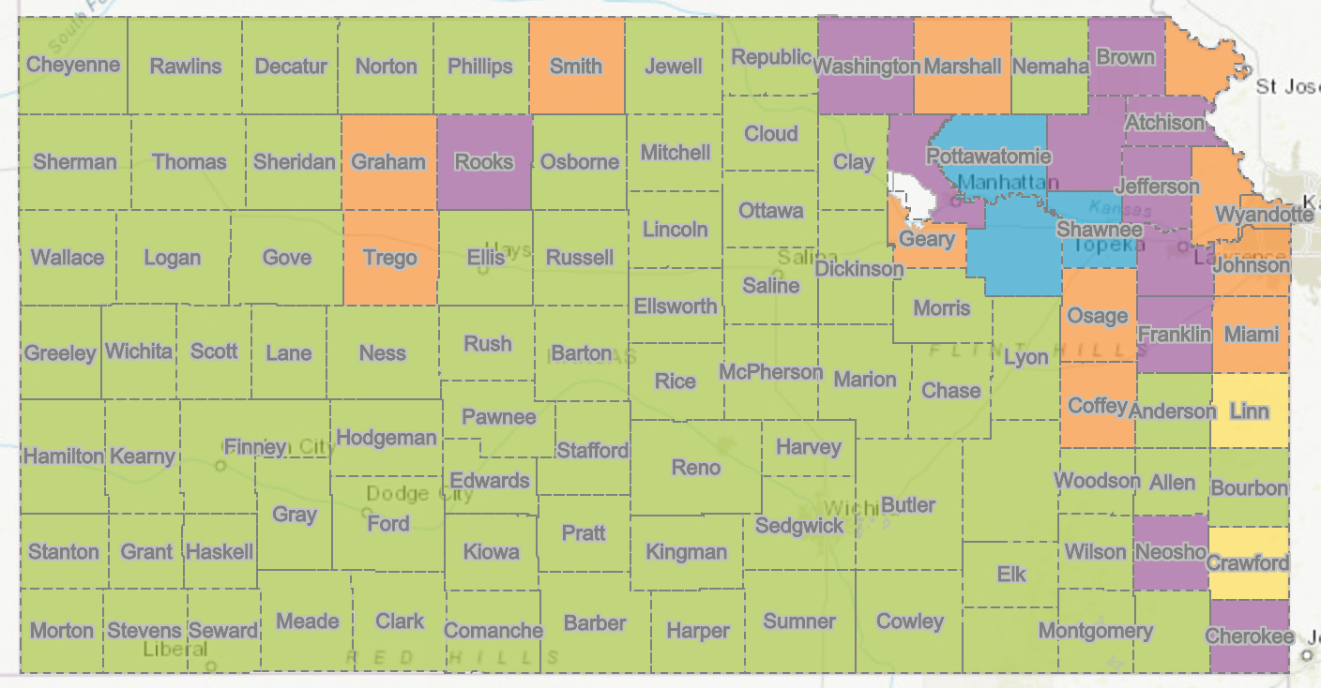
NG911 Project Update
82 PSAPs now on the hosted solution

Slide 5
NG911 Project Update
ESInet – Emergency Services IP Network
Reno County cut over – April 11, 2018
Historic event - first PSAP cut over to ATT National ESInet
*Next group of PSAPs scheduled to migrate over this summer

Slide 6
NG911 Project Update
Hosted Solution Mapping software
Vesta Locate
current mapping software used by call handlers
Product end of life announcement
Evaluating software update options, along with system requirements, project timeline, etc.
No change in NG911 GIS data submission process

Slide 7
NG911 Imagery Update
Acquisition complete for entire state
Statewide, 1-foot, leaf-off, natural color & CIR, orthoimagery
Estimated timeline:
Surdex is currently processing imagery
SurCheck QA/QC ~ July 2018
Services and file deliver fall/winter 2018
Access: Once delivered, imagery available by request on DASC website
High-resolution ”buy-up” program still available

Slide 8
NG911 Imagery Update
High-resolution buy up program
All buy-up projects will be designed and estimated based on the needs of each organization
Agreements between jurisdiction and Surdex
Available throughout 3 year contract
Tim Donze - TimD@SURDEX.COM

Slide 9
GeoMSAG and Geospatial Call Routing Update

Slide 10
News Items
Dickinson and Reno have switched out their MSAGs for geoMSAGs
The next 14 PSAPs to convert have been identified: Rice, Stafford, Harper, Barton, Kingman, Pratt, Barber, Comanche, Kiowa, Edwards, Pawnee, Hodgeman, Ford, Clark
The application needed to review future errors is not yet ready, so we are on hold temporarily
Overall alignment continues to improve with 76 counties over 99%

Slide 11
What to expect from the geoMSAG process
Possible questions about ESNs to help organize the move to the ESINet
Confirm responders for ALI display
Notification that your GIS data is about to be pulled so you can submit any last minute edits
You’ll need to decide who will be maintaining things going forward

Slide 12
What to expect from the geoMSAG process
Your data goes to West Safety Services through their Enterprise Geospatial Data Management System (EGDMS)
West goes through the process of creating the geoMSAG and replacing the standard MSAG
Once your geoMSAG is in place, you’ll get training on it’s ongoing maintenance

Slide 13
Things we’ve learned so far
If you don’t have 100% alignment before you switch, you’ll have to get there after you switch
Comprehension and Communication are key
If your GIS data is correct, you probably won’t have much to manage

Slide 14
NG911 Toolbox Update
Kristen Jordan Koenig

Slide 15
“New” Version- A Month Ago
Various small changes
Editing parsing in Check TN List- mostly for handling highways
Let me know if things aren’t parsing correctly
Biggest change- frequency check handling of blank/null values

Slide 16
Blank vs. Null Values
In GDB format, not identical-
In SHP format, identical-
We don’t want identical records.

Slide 17
Migrating to 2.1- Deadline- June 30 Submission
You have 4 weeks- 17 PSAPs left to convert
If you need to migrate- START TOMORROW
If you haven’t migrated yet, remember: YouTube training video & a how-to document
LET ME KNOW ASAP IF YOU HAVE ISSUES
Procrastination has natural consequences.

Slide 18
Future Developments
ESB topology- the tool will check polygon topology and report issues as Notices
These will be errors eventually
If you’ve kept up on your topology checking, this won’t be an issue
Orion address & NG911 address comparison- on hold until a few of the NG911 data requirements slow down

Slide 19
NG911 GIS User Group
NG911 GIS Local Data Steward & Data Maintainer Certification Classes
Hays – June 5, 2018
Topeka – August 21, 2018
Next NG911 GIS User Group webinar
August 2018

Slide 20
NG911 GIS User Group
Thank you!
Kansas 911 Coordinating Council website
http://www.kansas911.org/
DASC - Initiatives>NG911
http://www.kansasgis.org/initiatives/NG911/

