Slide 1
Contingency & Overflow on ESInet
MOU Day
Salina, Ks
05/21/2018

Slide 2
Contingency & Overflow
Contingency and Overflow planning is the basis of routing policy in the ESInet environment.
ESInet routing allows for much more flexibility and automation than legacy routing
To take advantage of the extended capabilities of ESInet routing, calls must be kept in the ESInet environment – routing to administrative lines moves the call out of the ESInet environment and into the PSTN
Routing to administrative lines will be a last resort option for routing
Notes:
All contingency & overflow plans are automatic on ESInet. No call to the Res Center to enact.

Slide 3
Contingency
PSAP Evacuation
Equipment failure at PSAP
Loss of connectivity to host on both primary and backup circuits
No Agents Logged on for PSAP
Notes:
Reasons why Contingency plan would be enacted

Slide 4
Contingency Routing
911
ESInet
911
Admin
911
911
Notes:
Illustrates contingency plan steps:
1. Normal routing
2. Route to neighboring PSAP
3. Route to PSAP at least one County away
4. Route to PSAP on opposite host
5. Route to admin at original PSAP

Slide 5
Overflow
PSAP online but unable to answer some or all calls
Surge Event
Emergency Evacuation – Agents still logged on

Slide 6
Overflow Routing
911
ESInet
911
Admin
911
911
Notes:
Could be the same as Contingency routing

Slide 7
Overflow Routing
ESInet
Notes:
Could be a different

Slide 8
OR – Overflow via Vesta
ESInet Delivers Call to Vesta Bound for PSAP #1
PSAP # 1
PSAP # 2
PSAP # 3
PSAP # 4

Slide 9
NG 9-1-1 Reroute/overflow
Multi-Layer Approach
ESInet Delivers Call to Vesta
Bound for PSAP #1
PSAP # 1
PSAP # 2
Each PSAP has an overflow queue that appears on their Call Handling Screen
PSAP 1 OVFL
PSAP 2 OVFL
PSAP # 3
PSAP # 4
PSAP 3 OVFL
PSAP 4 OVFL

Slide 10
NG 9-1-1 Reroute/overflow
Multi-Layer Approach
ESInet Delivers Call to Vesta
Bound for PSAP#1
PSAP # 1
PSAP # 2
Each PSAP has an overflow queue for any PSAP that they agreed to take overflow for.
PSAP 1 OVFL
PSAP 2 OVFL
PSAP 2 OVFL
PSAP 3 OVFL
PSAP # 3
PSAP # 4
PSAP 3 OVFL
PSAP 4 OVFL
PSAP 4 OVFL
PSAP 1 OVFL

Slide 11
This example shows a single overflow queue. There would be an overflow queue for every PSAP you agreed to take calls for. They could be stacked on a tab behind other call queues.

Slide 12
After a pre-determined time, an unanswered call would fall into the overflow queue. It would ring in the overflow queue at both the initial PSAP and the backup PSAP. Either party could answer out of the overflow queue and either can barge in on the call while it is in progress in that queue.

Slide 13
MOU
Ensures that agreements to receive calls carry forward with changes in administration and personnel
Ensures understanding of what calls will be received by the PSAP
Ensures understanding of what the procedure for handling these calls once received will be
Ensures understanding of any process or procedures that will be implemented in contingency or overflow situations

Slide 14
MOU
The Contingency example would require Reno County to have MOU’s signed with:
Harvey County
Sumner County
Saline County
Each PSAP will need to get MOU’s executed with each PSAP that they intend to use in their contingency & overflow plan

Slide 15
MEMORANDUM OF AGREEMENT
BY AND BETWEEN
Rice County Emergency Communications
AND
Hutchinson/Reno County ECC
This Memorandum of Agreement (hereinafter “Agreement”) is made and entered into on March 21, 2018, by and between Rice County Emergency Communications (PSAP 1) and Hutchinson/Reno County ECC (PSAP 2).
WHEREAS, the parties to this Agreement are participants in the Statewide NG9-1-1 System, and;
WHEREAS, the parties to this Agreement desire to provide contingency and/or overflow backup to one another, and;
WHEREAS, the parties desire to formalize their decisions regarding said contingency and/or overflow backup;
THEREFORE, the parties agree as follows:

Slide 16
☒ Hutchinson/Reno County ECC will accept reroute of all 9‐1‐1 calls from Rice County
Emergency Communications due to PSAP evacuation, network or customer premise
equipment failure, no workstation logged on, or other condition.
PSAP 2 will deliver any answered calls under this provision back to PSAP 1 jurisdiction by
radio on KSICS talkgroup SC9‐LE
☒ Hutchinson/Reno County ECC will accept overflow calls from Rice County Emergency
Communications when all 911 SIP trunks at PSAP 1 are busy.
PSAP 2 will deliver any answered calls under this provision back to PSAP 1 jurisdiction by
Smoke signal
☒ Hutchinson/Reno County ECC will accept overflow calls from Rice County Emergency
Communications when a call goes unanswered for a period of 36 seconds. PSAP 2
agrees to place an overflow queue for PSAP 1 on the call handling screen.
PSAP 2 will deliver any answered calls under this provision back to PSAP 1 jurisdiction by
Facebook post

Slide 17
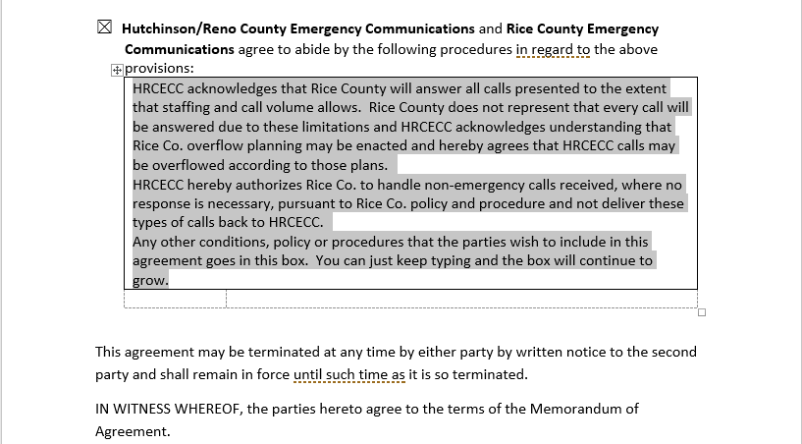

Slide 18
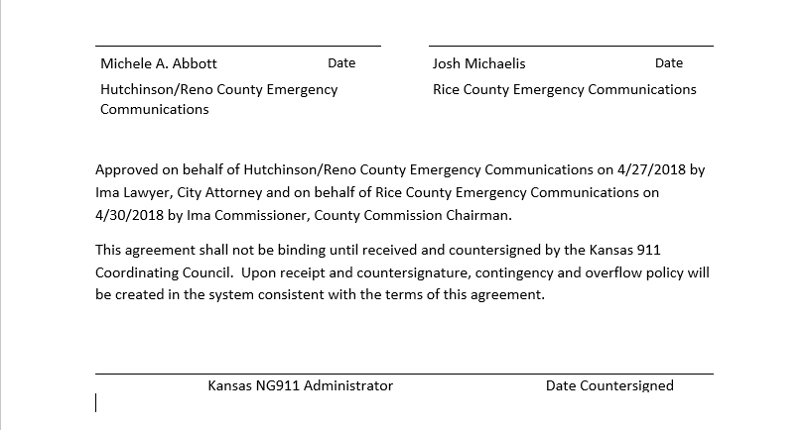

Slide 19
What Changes?

