Slide 1
NG911 GIS User Group
2018 Q1 Meeting
February 27, 2018
https://kansas.zoom.us/j/676319798 1 646 876 9923
Meeting ID: 676 319 798

Slide 2
Agenda
Project Update
Preparing GIS Data for Geospatial Call Routing
NG911 Toolbox Update
NG911 Program Portal
Future news and dates

Slide 3
NG911 Project Update
2017 Q4 submission – 100% participation
Kansas NG911 GIS Data Model v2.1
High adoption rate
V2.1 by Q2 June 30, 2018 deadline

Slide 4
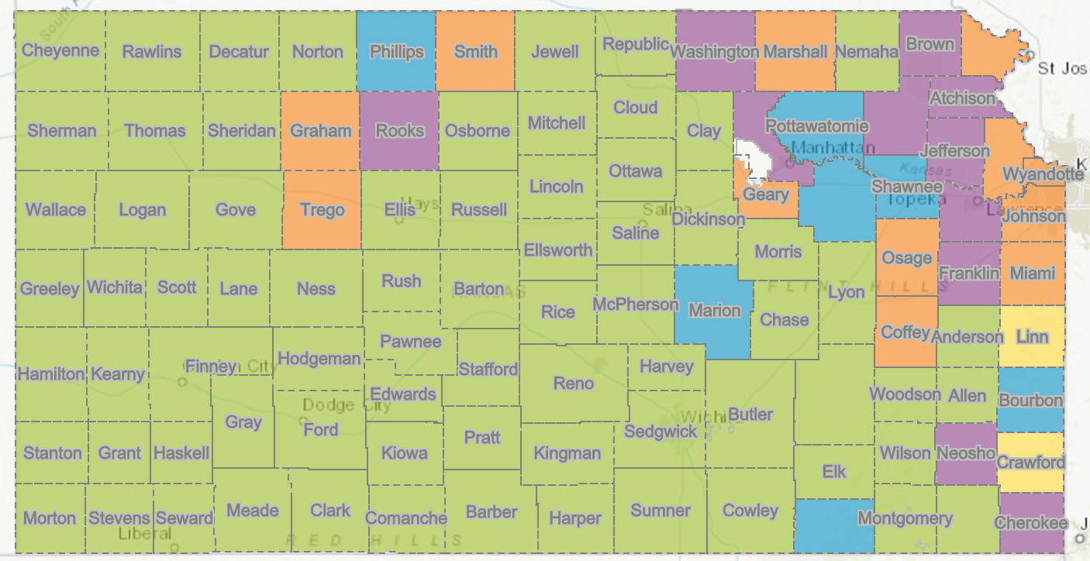
NG911 Project Update
78 PSAPs now on the hosted solution

Slide 5
NG911 Imagery Update
2014/15 1-foot, leaf-off, imagery available for download on DASC website
7 jurisdictions have contracts in place for local imagery (6” or 3”)
All buy-up projects will be designed and estimated based on the needs of each organization
Agreements between jurisdiction and Surdex
Available throughout 3 year contract
Tim Donze - TimD@SURDEX.COM
SurCheck – web based image inspection tool
Local partners

Slide 6
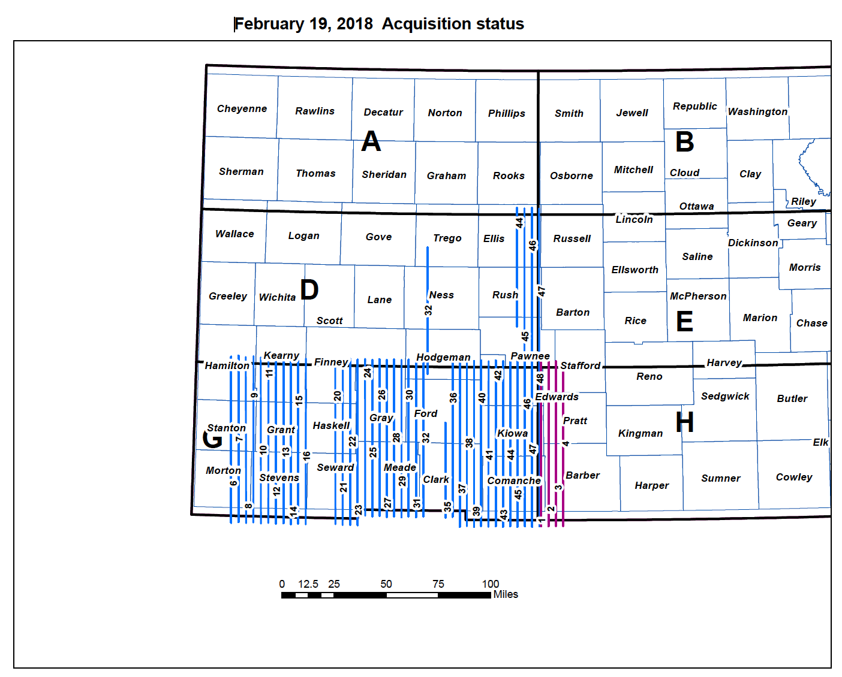
NG911 Imagery Update

Slide 7
Preparing GIS Data for Geospatial Call Routing

Slide 8
Step 1: Keep the GIS data current

Slide 9
Step 2: Make sure all TN addresses geocode successfully

Slide 10
The “To Do” List
Review your GIS/MSAG Alignment Report
Work the problems using the instructions included with the report until you don’t have any more problems
If you aren’t friends with your MSAG Coordinator, work on that

Slide 11
How long do I have to get this done?
Hutch/Reno County (Late March)
Rice County (Late April)
Kingman County (Late April)
Barton & Harper (Mid May)
Pratt & Stafford (Mid May)
Barber & Comanche (Mid May)
Edwards & Kiowa (Late May)

Slide 12
Next Group: Allen, Bourbon, Butler, Chase, Clark, Cowley, Elk, Ford, Finney, Grant, Gray, Greeley, Greenwood, Hamilton, Harper, Harvey, Haskell, Hodgeman, Kearny, Labette, Lane, Lyon, Marion, McPherson, Meade, Morton, Pawnee, Scott, Sedgwick, Seward, Stanton, Stevens, Sumner, Wichita, Wilson, Woodson
After that: Anderson, Cheyenne, Clay, Cloud, Decatur, Ellis, Ellsworth, Franklin, Jewell, Lincoln, Logan/Gove, Mitchell, Morris, Nemaha, Ness, Norton, Osborne, Ottawa, Phillips, Pottawatomie, Rawlins, Republic, Rush, Russell, Saline, Shawnee, Sheridan, Sherman, Thomas, Wallace
Local Determination: Atchison, Brown, Cherokee, Coffey, Crawford, Doniphan, Douglas, Geary, Graham, Jackson, Jefferson, Johnson, Leavenworth, Linn, Marshall, Miami, Neosho, Osage, Riley, Rooks, Smith, Trego, Washington, Wyandotte

Slide 13
Step 3: Replace the MSAG with a GIS-derived MSAG

Slide 14
The MSAG

Slide 15
The Road Centerline Feature Class

Slide 16
GIS-derived MSAG (geoMSAG)

Slide 17
Step 4: Keep everything updated

Slide 18
Keeping everything updated
Your GIS data submissions will be automatically forwarded to the GeoMSAG
Someone at your agency will need to review any TN fallout from your GIS edits

Slide 19
NG911 Toolbox Update
Kristen Jordan Koenig

Slide 20
New Version- Last Week
Biggest improvement- in #3 Check Roads, overlapping address range check is now isolated
You can run other tests quickly
Still run a full check before submitting
Overlapping address range check should be slightly faster

Slide 21
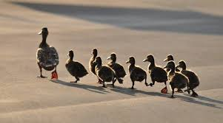
Migrating to 2.1
If you haven’t, remember: YouTube training video & a how-to document
Easier if: you get your ducks in a row first

Slide 22
Future Developments
Orion address & NG911 address comparison
Not required check
Beneficial if there’s a good relationship between Data Maintainer and appraiser’s office

Slide 23
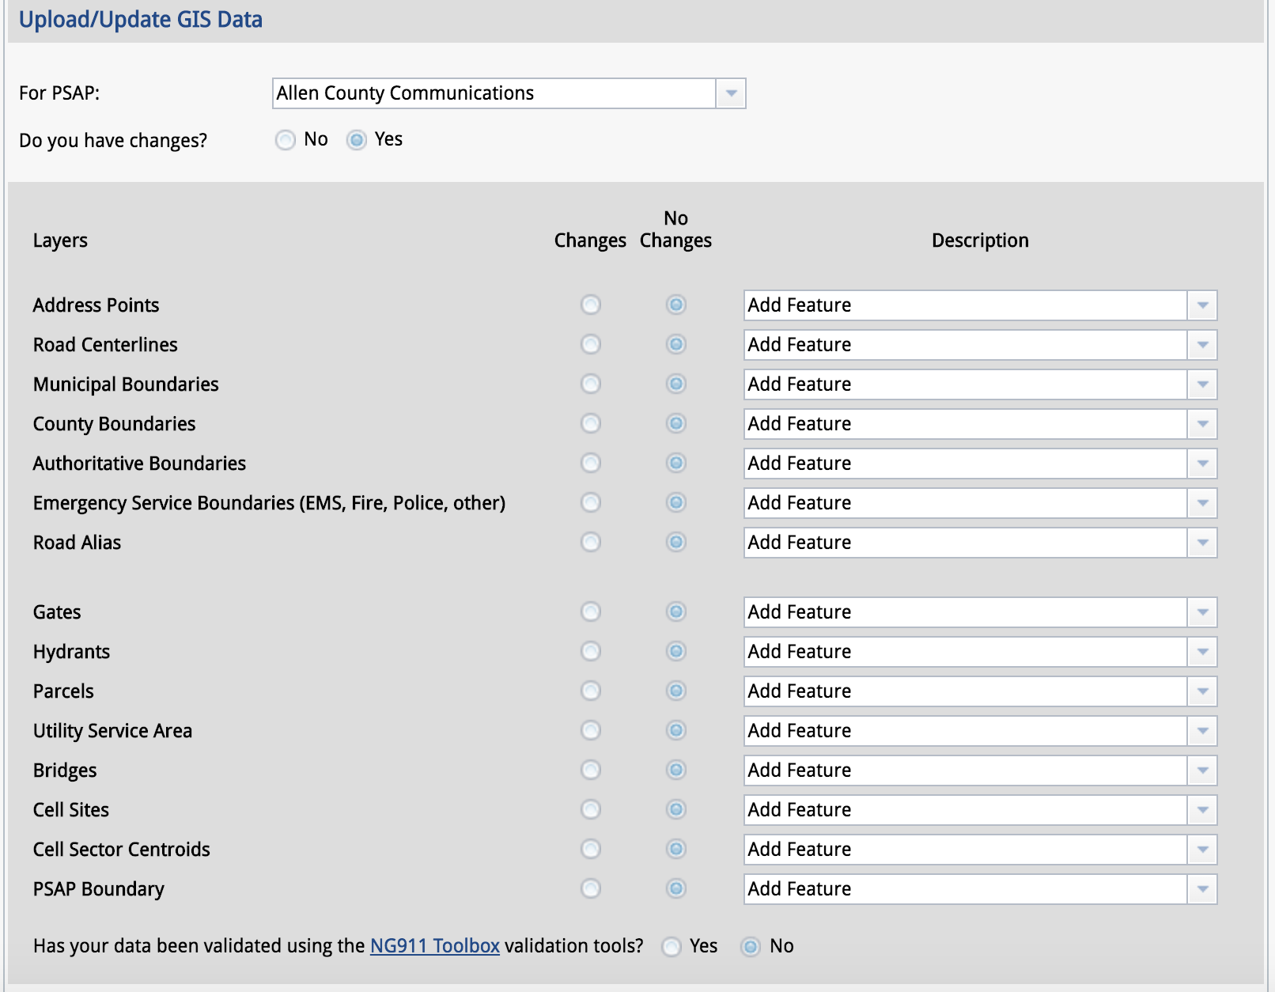
NG911 Program Portal
ESB

Slide 24
NG911 Program Portal
ESB combined to accommodate additional, optional ESB data layers in Vesta Locate
NG911 GIS Data Model - Section 5.3
Optional ESB layers may be named as the Data Steward wishes. Only the “ESB_” prefix is required
Ex: ESB_Rescue

Slide 25
NG911 GIS User Group
Next NG911 GIS Data submission deadline
March 31, 2018
Next NG911 GIS User Group webinar
May 2018
NG911 GIS Local Data Steward & Data Maintainer Certification Classes
Kansas Spring APCO Conference, April 16-18, 2018
GIS Local Data Steward Certification Class
Additional dates and locations coming soon!

Slide 26
NG911 GIS User Group
Thank you!
Kansas 911 Coordinating Council website
http://www.kansas911.org/
DASC - Initiatives>NG911
http://www.kansasgis.org/initiatives/NG911/

