Slide 1

NG911 GIS User Group
2017 Q4 Meeting
October 20, 2017
Kansas Association of Mappers (KAM) Annual Conference

Slide 2
Project Update:
NSGIC Geospatial Excellence : Catalyst Award
2017 Q3 submissions - 100% participation
NG911 Vesta User Group
Kansas NG911 GIS Data Model v2.1

Slide 3
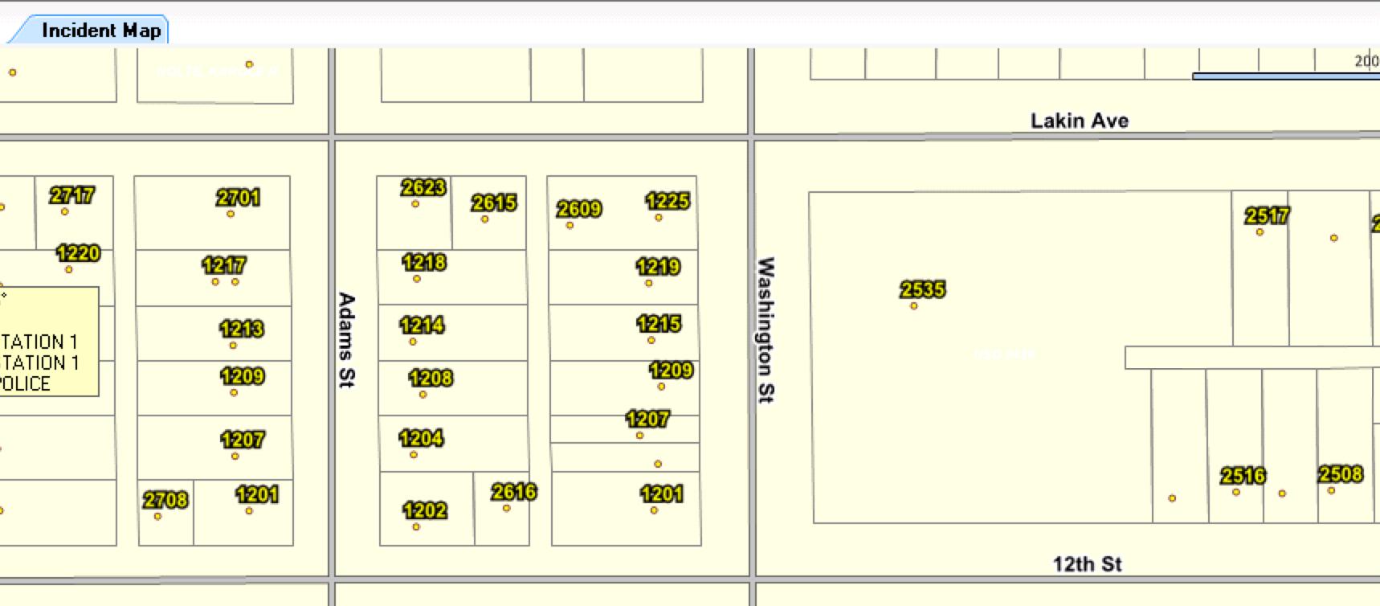
NG911 Vesta User Group
Parcels
  Identify for more information

Slide 4
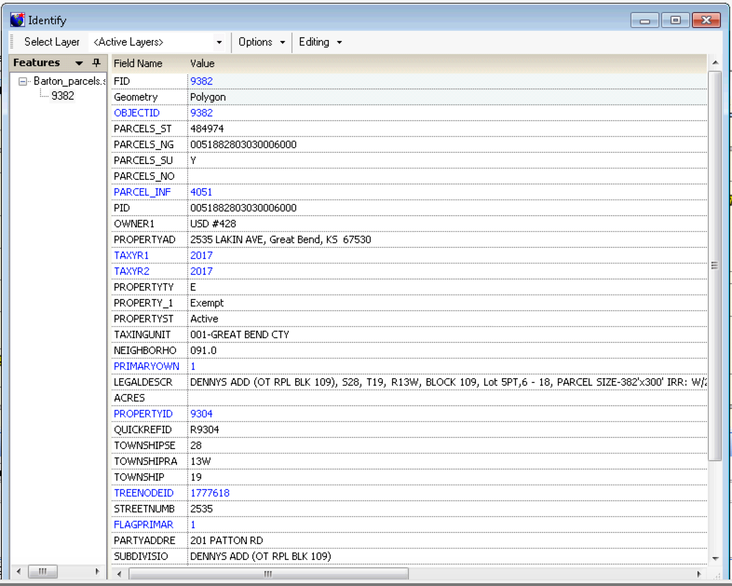
NG911 Vesta User Group
Parcels

Slide 5

NG911 Imagery Update
Project highlights
Renewed 3-year agreement with Surdex/Hexagon to update statewide imagery
Statewide, leaf-off, 1-foot, natural color & CIR
Acquisition will start in western Kansas Jan/Feb 2018
Access to other HxIP imagery web service formats
Public domain release of 2014/15 1-foot, leaf-off, imagery coming soon
Primarily funded by Kansas 911 Coordinating Council, with cost-share provided by the Traffic Records Coordinating Council (TRCC), and the Kansas Department of Revenue (KDOR)

Slide 6
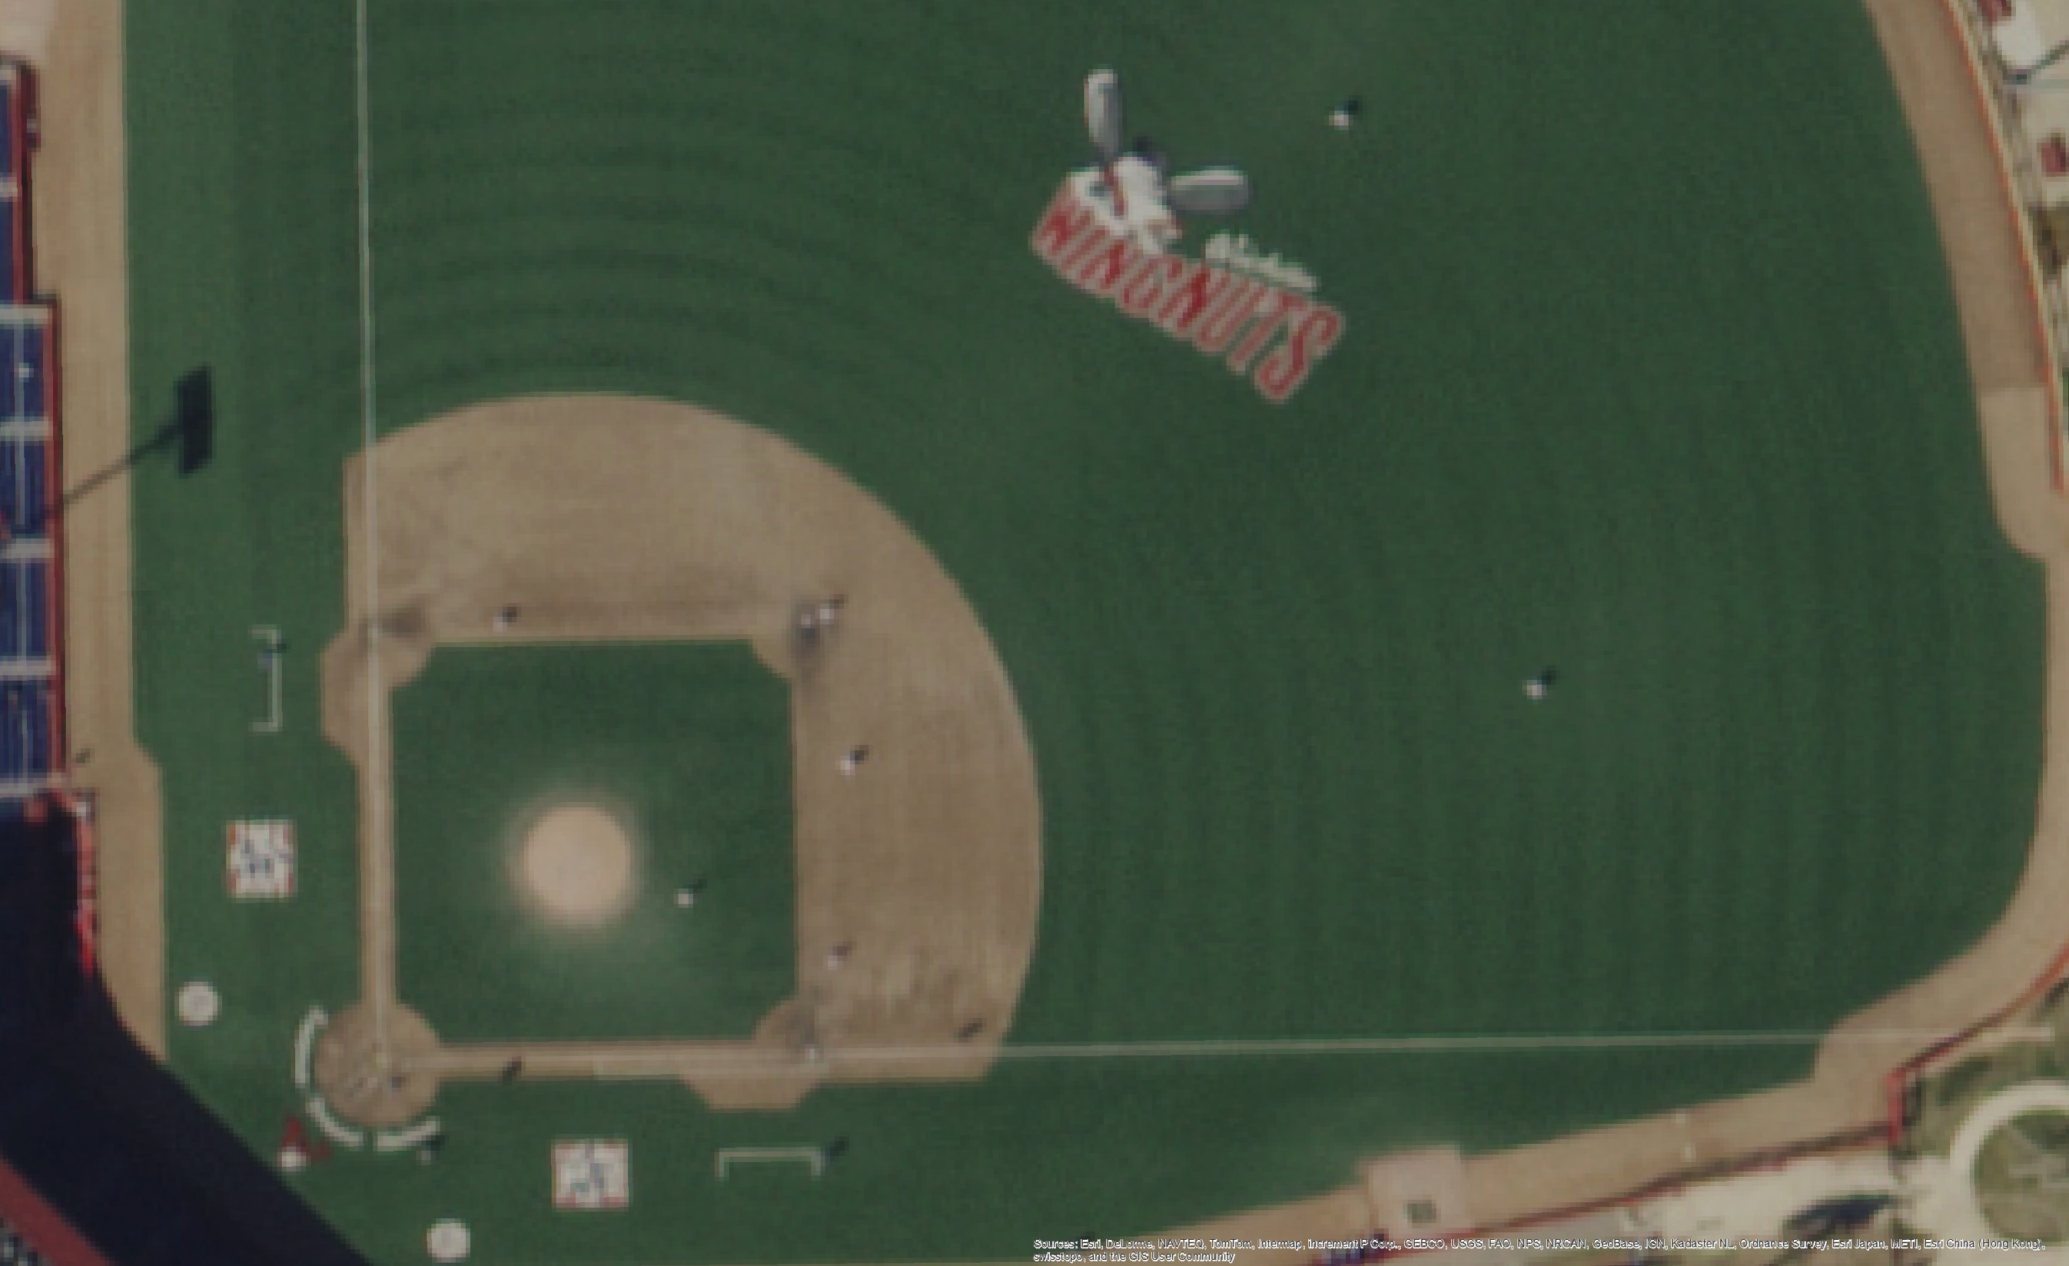
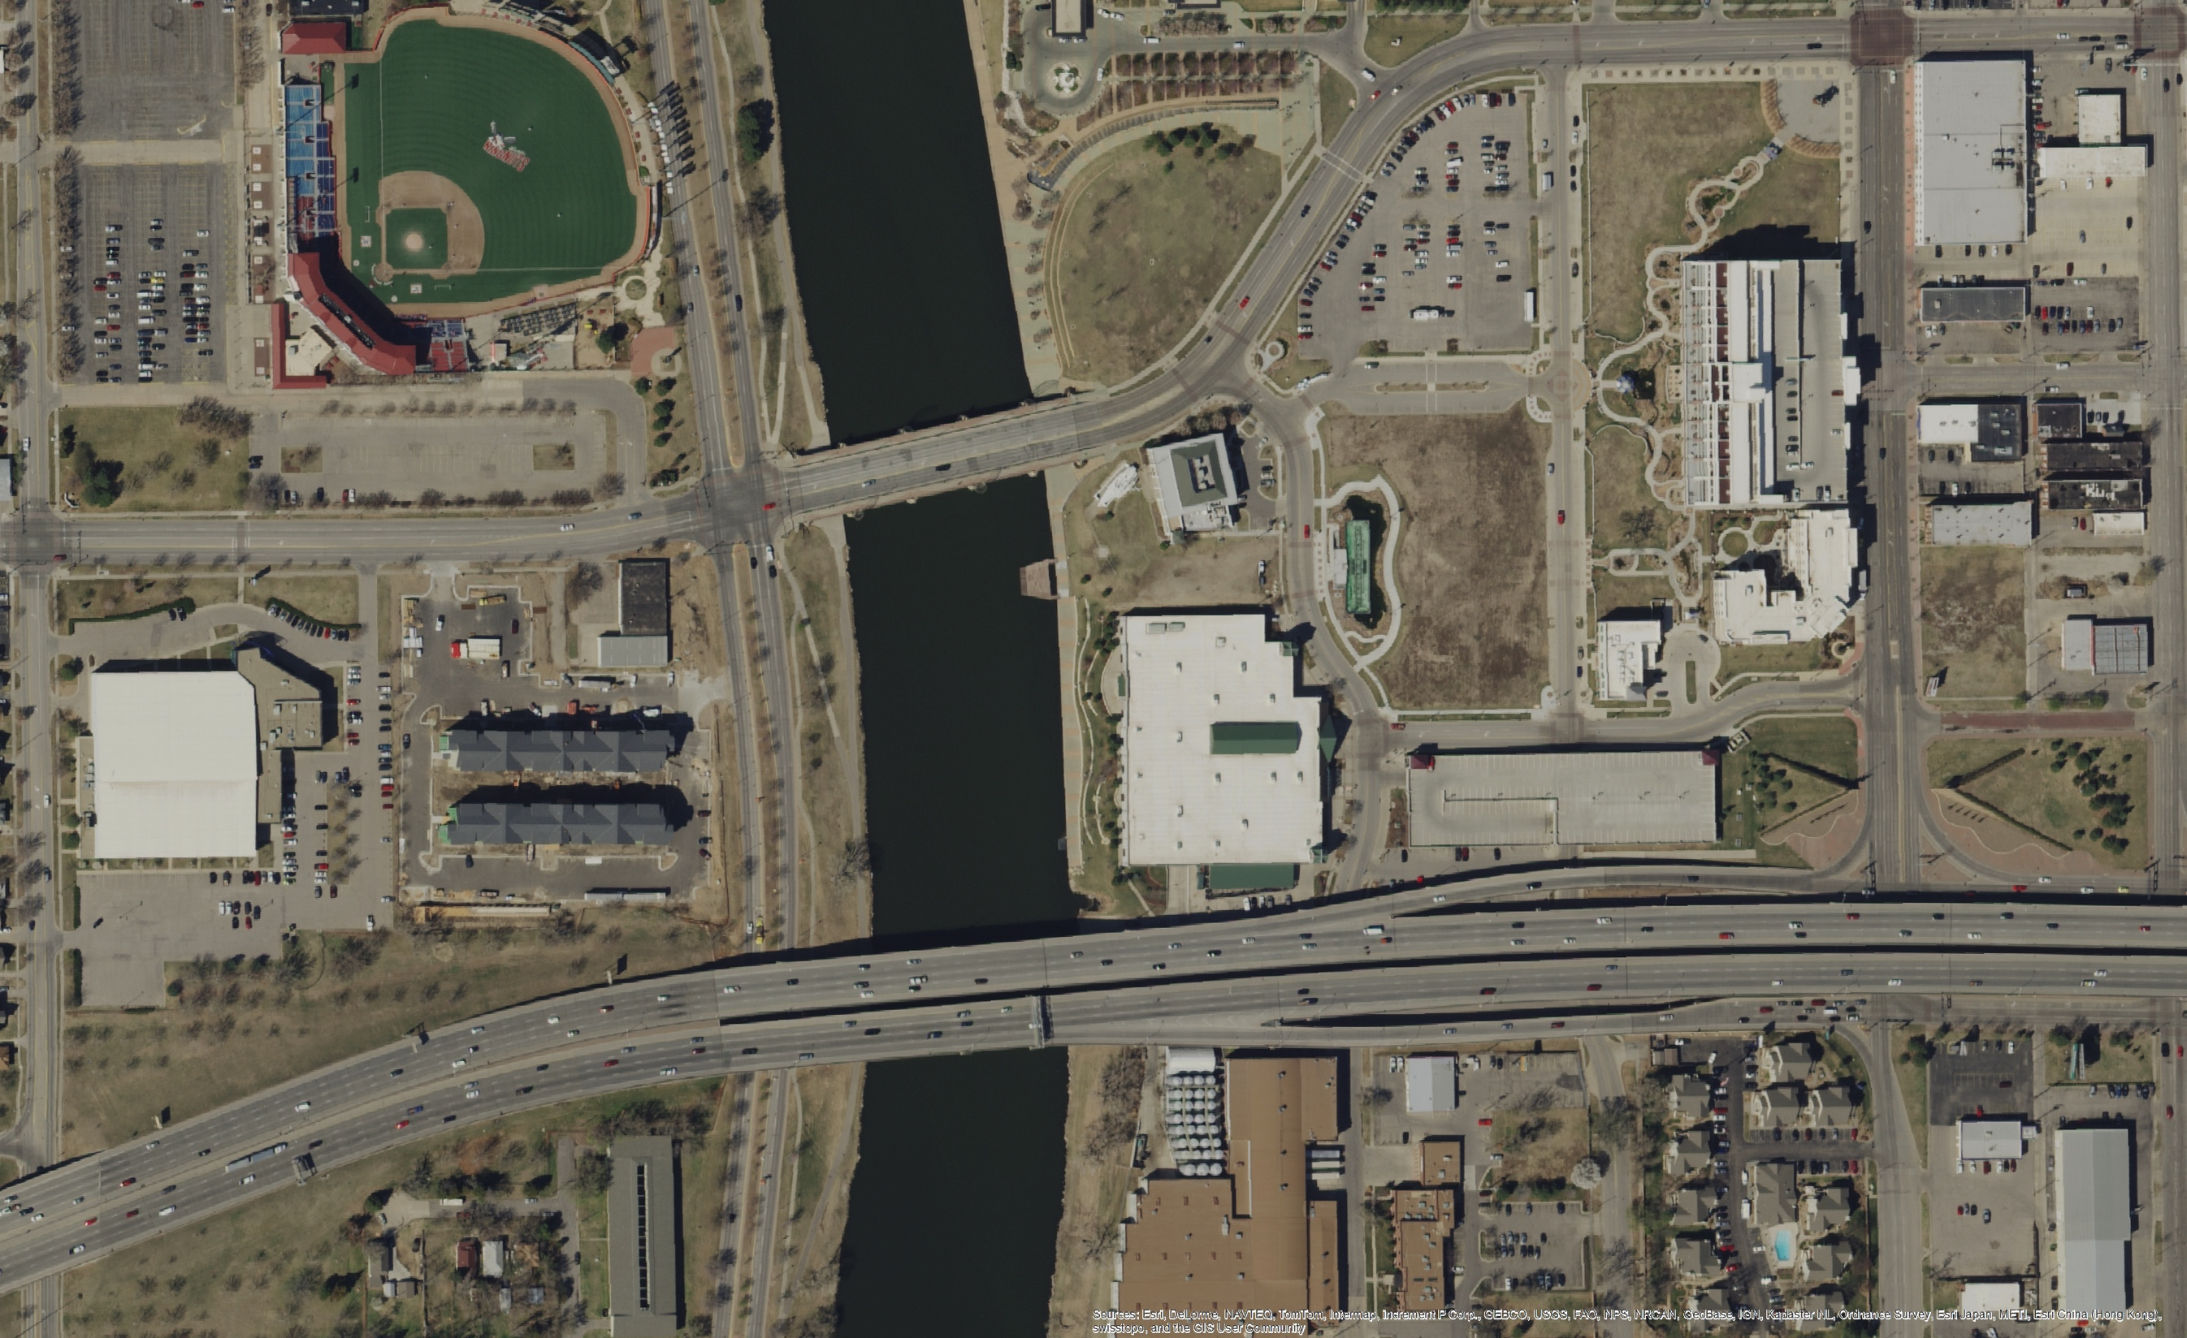
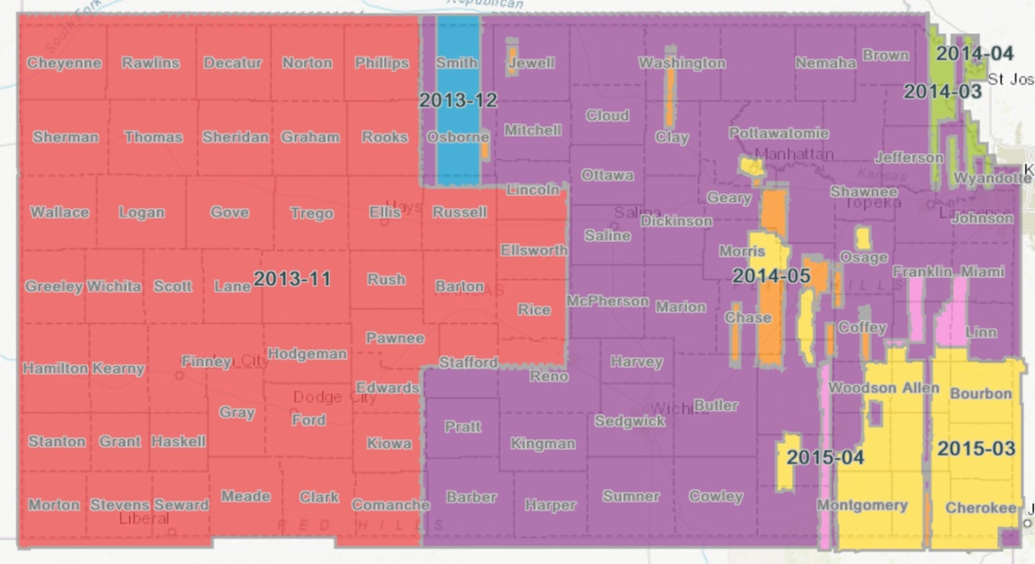
NG911 Imagery Update
License allows access to the following:
  State, county, and municipal (city) government agencies/department
  Regents institutions
  All Public School Districts
  Any firm doing work on behalf of one of these entities
  No public domain distribution
Formats:
  GeoTIFF
  MrSID compressed
  WMS
  Esri REST

Slide 7
NG911 Imagery Buy-up Program
Take advantage of mobilization of resources for statewide project
All buy-up projects will be designed and estimated based on the needs of each organization
Agreements between organization and Surdex
Buy-up imagery is not part of the subscription program

Slide 8
NG911 Toolbox Update

Slide 9
Edits to Validation Tools
Address ranges- check against respective parity
Check TN List- cascades to check address points after road centerline
MSAGCO- validation checks for leading & trailing spaces
MSAGCO- adjustment tool fixes leading & trailing spaces

Slide 10
Other Fixes
Various tweaks to other scripts (all in the next release GitHub change log)
Added reporting for overlapping address ranges to FieldValuesCheckResults & in an additional text file- specifies which address in which segments overlap

Slide 11
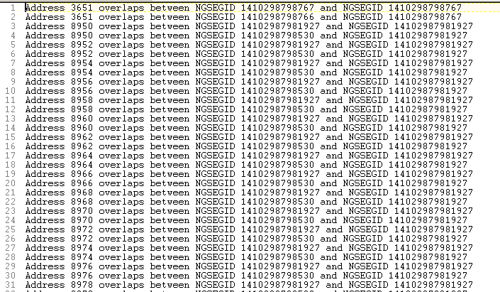

Slide 12
Conversion from 2.0 to 2.1
Multi-step conversion process
This auto-fills all new attributes
The tools are numbered
Some attributes will need review
There will be documentation on how to do the conversion
YouTube video? Yes? No?

Slide 13
Other Notes
Validation tools will work on 2.0 & 2.1 gdbs
Geocompare Address Points will have option in 2.1 to just fill in blank RCLMATCH fields
Geocompare in 2.1 will repopulate RCLMATCH field

Slide 14
NG911 GIS User Group
Next NG911 GIS Data submission deadline
  December 31, 2017
Next NG911 GIS User Group webinar
  February 2018

Slide 15
NG911 GIS User Group
Thank you!
Kansas 911 Coordinating Council website
http://www.kansas911.org/
DASC - Initiatives>NG911
http://www.kansasgis.org/initiatives/NG911/

