Slide 1

NG911 GIS User Group
2017 Q3 Webinar
August 29, 2017
10:00 – 11:00am
https://kansas.zoom.us/j/123272980
1 408 638 0968
Meeting ID: 123 272 980

Slide 2
NG911 GIS User Group
Purpose: Outreach and coordination effort to discuss and update users on NG911 GIS related project topics
Agenda
NG911 Project Update
GIS Committee Activities & MSAG/GIS Alignment update
NG911 GIS Toolbox
Announcements & next webinar

Slide 3
NG911 GIS User Group
Project Update
2017 Q2 data maintenance submission results
Kansas/Oklahoma NG911 GIS Summit - pending
Vesta Locate (Hosted Solution mapping software)
  Optional data layers: Fire Hydrants, Parcel Boundaries, Gates
  More optional data layers will be included in the next GIS Data Model v2.1

Slide 4
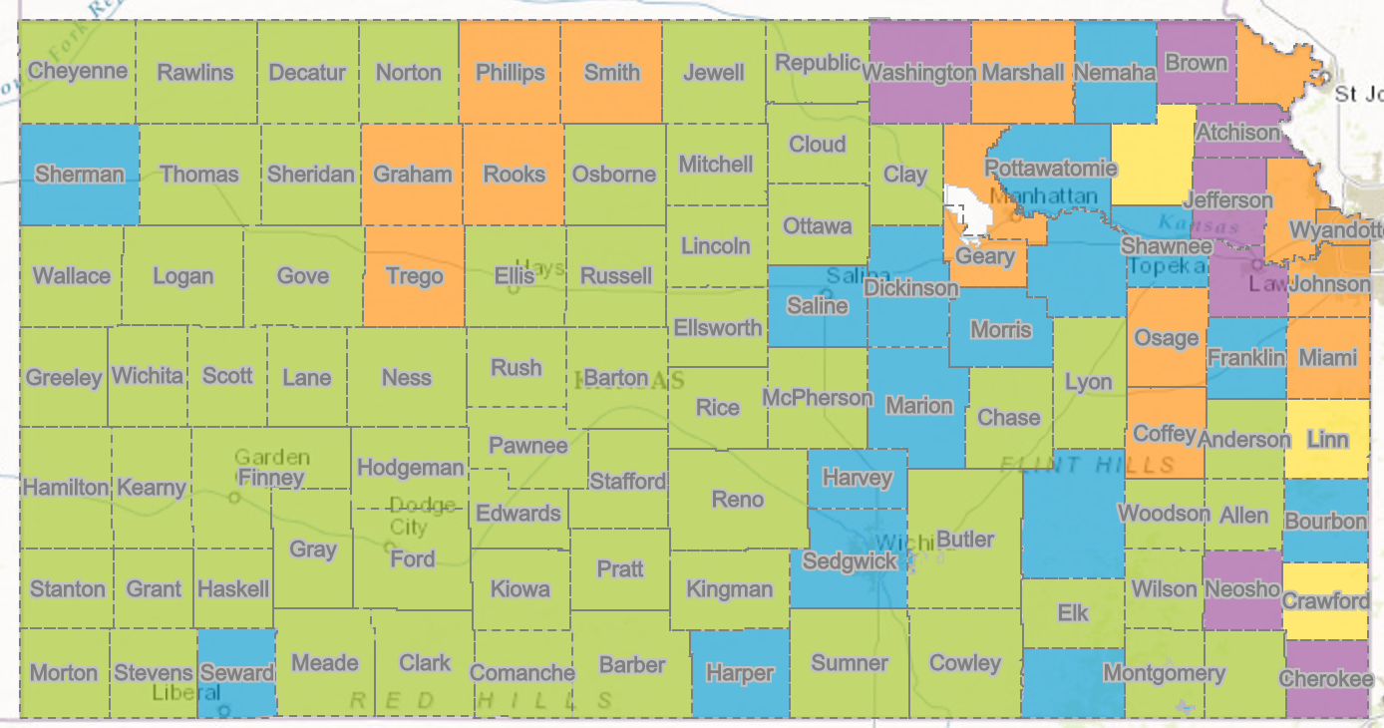
NG911 GIS User Group
Hosted Solution Deployment Status Map

Slide 5
NG911 GIS User Group
New Kansas 911 Coordinating Council website
  http://www.kansas911.org/

Slide 6
NG911 GIS User Group
NG911 Imagery update
  Imagery contract extension being finalized
  Local buy up options will be available
  New imagery will include CIR
    4-band GeoTIFF, natural color and CIR web services, natural color MrSID
  Anticipate acquisition over two flying seasons with priority for western Kansas. Initial data collection will likely be delivered August/September, 2018.
  2013-2015 NG911 imagery will be made publicly available after contract is final

Slide 7
MSAG & GeoMSAG
July Alignment Reports
Moving the bar
Time frame for conversions

Slide 8
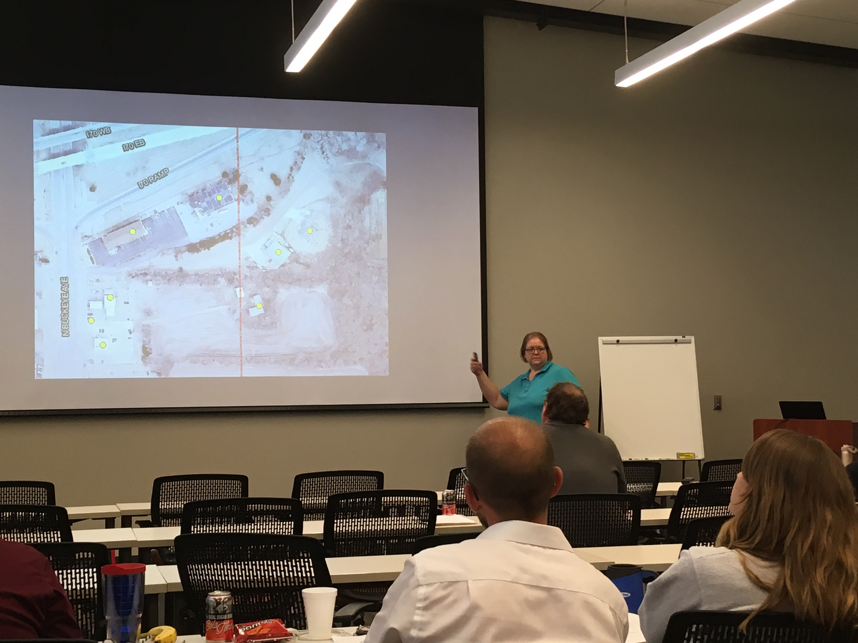
Upcoming Training
Data Steward and Maintainer in Manhattan on September 27
Data Steward at Fall APCO Conference
Data Maintainer at KAM Conference

Slide 9
GIS Data Model
Version 2.1 is currently being reviewed by vendors who are identified Data Maintainers
Will go out for public review later this week
Proposed changes
  New fields to support GeoMSAG creation
  Removing road geometry recommendations not related to attributes
  Adding Utility service areas and Bridges as optional layers for Vesta Locate
Updated templates and conversion scripts will be provided

Slide 10
GIS Committee

Slide 11
Toolbox Updates
Major changes- how these run & their names
  Geocompare Address Points
  Check AT&T TN List/Check Other TN List
Directly compare an address list to the road centerline file

Slide 12
Toolbox Updates
Edited Overlapping Address tool
Totally ArcPro compatible
Fixed a few additional user-reported bugs

Slide 13
Immediate Future
A few additional user-reported bugs, but none are emergencies
Check TN List tools will cascade to compare against the address point file

Slide 14
Looking ahead
Next geodatabase model
Tools to assist with conversion
Auto-populate new attributes
Orion comparison tool- address point to Orion situs address
  Did some initial testing, not too shabby
  Of 19 counties I tested, 12% of the addresses didn’t match well
  Could help double-check both NG911 & Orion data

Slide 15
NG911 GIS User Group
Next NG911 GIS Data submission deadline
  September 30, 2017
Next NG911 GIS User Group webinar
  Session at KAM Conference

Slide 16
NG911 GIS User Group
Thank you!
Kansas 911 Coordinating Council website
http://www.kansas911.org/
DASC - Initiatives>NG911
http://www.kansasgis.org/initiatives/NG911/

