Slide 1
Kansas NG9-1-1 GIS Data Model
Model Standards and Data Remediation Workshop

Slide 2
Welcome
Workshop is scheduled from 10-2
Lunch will be here around 11:30
Questions are welcome anytime

Slide 3
NG9-1-1 Primer

Slide 4
E9-1-1 NG9-1-1
Call is placed
Call is placed
MSAG
Selective Router
ESInet
GIS
PSAP
PSAP
Notes:
There may not be a service provider.

Slide 5

What’s Driving NG9-1-1
    Newer Technologies/Services
      Text, Image, Video, Telematics, Sensors, Subscriber Info
    Improve Survivability
      Network Resilience, Virtual PSAPs
    Improve Interoperability and Information Sharing
    Need to “Mainstream” 9-1-1 Technology

Slide 6
How NG9-1-1 is Different
Technology:
  Packet Based vs Circuit Switched
Functions:
  Replicates E9-1-1 capabilities
  Adds new capabilities
  GIS vs Tabular MSAG
No longer a ‘local’ service:
  Interoperability at county, region, state and national
  levels

Slide 7
The Role of GIS in NG9-1-1
GIS Database
LVF
or
Location Validation Function
ECRF
or Emergency Call Routing Function

Slide 8
GIS and the LVF
GIS Database
Constantly updating the LVF*
Is this address good?
Location Validation Function
Yes. Do your thing.
The Service Provider has an address to check…
Or
No! Stop! Fix it!
…before installing a land line
…before accepting a VOIP location
…while testing existing records to be sure they are still good
* This is also called “provisioning through the SIF”

Slide 9
A Next-Gen 9-1-1 Call
Someone dials 911
ECRF
ESInet
Lots of things happen in here. Fortunately, we only have to know about this one.
PSAP

Slide 10
GIS and the ECRF
GIS Database
Constantly updating the ECRF*
Emergency Call Routing Function
has
two jobs
Route the call to the right PSAP
Call comes in
Job 1
Job 2
Determine additional call information
NENA has lots of cool ideas for what this information will be, but all of it depends the call location successfully resolving against the GIS data
* This is also called “provisioning through the SIF”

Slide 11
The ability to route emergency calls will depend on standardized GIS data that is both current and accurate

Slide 12
MSAG Remediation

Slide 14
Road Centerline | MSAG | MARKS Thoughts
10000-9535 41ST AVE 5192 | 8000-21113 41ST AVE 5192 | Centerline appears to be reversed. Some of the hundred blocks show the postal city of Lewis and some as Haviland. If the ESN covers a city the city name should be used. If in county the ESN should either be shown as Kingman County or if the ESN is set up that way then the township.
12000-23538 43RD AVE 5192 | 12000-23999 43RD AVE 5193 | Some of the hundred blocks show the postal city of Lewis and some as Haviland. If the ESN covers a city the city name should be used. If in county the ESN should either be shown as Kingman County or if the ESN is set up that way then the township.
15267-9536 7TH AVE 5191 | 9000-18999 7TH AVE 5191 | Centerline appears to be reversed. Also 2 split segments present with a few miles in between
100-604 E CHESTNUT ST 5193 | 204-602 E CHESTNUT ST 5193 | Looks good. Doesn't appear to be any addresses in the 100 blk so that is why they are not in the MSAG.
200-620 E MOCKINGBIRD LN 5192 | 200-599 E MOCKINGBIRD LN 5192 | Couldn't locate. Possibly the old trailer park just south of Greensburg?
4000-5527 E ST 5191 | 4000-5999 E ST 5191 | Some of the hundred blocks show the postal city of Mullinville and Offerie If the ESN covers a city the city name should be used. If in county the ESN should either be shown as Kingman County or if the ESN is set up that way then the township.
21000-29530 H ST 5193 | 101-123 HIGH ST 5193 | Agree checked againt wrong centerline
400-806 N WICHITA AVE 5193 | 404-810 N WICHITA AVE 5193 | OK may need to lower MSAG to match 806 in centerline
100-922 S BAY ST 5192 | 201-1002 S BAY ST 5192 | OK may need to lower MSAG to match 922 in centerline
100-620 S OAK ST 5192 | 102-1630 S OAK ST 5192 | Appears street ends in 600 blk and picks up again in the 1200 blk. The 1200 blk apprears to be in the county.

Slide 15
Kansas NG9-1-1
GIS Data Model

Slide 16
Document Conventions
Requirements vs. Recommendations
  “Shall” and “Must”
  “Recommended” and “Preferred”
Data stewards = Whomever is responsible for maintaining the data
Data aggregation and the data aggregator

Slide 17
Authoritative Data Only
All features submitted by the data steward must be inside their authoritative boundary polygon(s)

Slide 18
General Attribute Standards
The attribute type must match with the type in the standard
  A = Alphanumeric = Text field
  D = Date and time = Date field
  N = Numeric = Integer field
  ND = Numeric, Decimal = Decimal field
Every attribute is listed as Mandatory, Conditional or Optional

Slide 19
General Attribute Standards, cont.
Everything in the table must be there, and the fields should be in the same order
If field names are different than in the standard, metadata must show how the fields map to the standard
Every record must have a persistent unique identifier within the local data (not the ObjectID)
If there is a domain, it represents the only valid values for the attribute

Slide 20
Road Centerlines - Geometry
All public and addressed private roads
Segments must be broken at:
  Every intersection with another segment
  Every State, County, Municipal, ESB and ESZ boundary
  Any change in road name
  Any change in surface type, if used
Required to be on the road surface in aerial photography. Recommended within 10’ of the center.
Line direction moves from low to high address

Slide 21
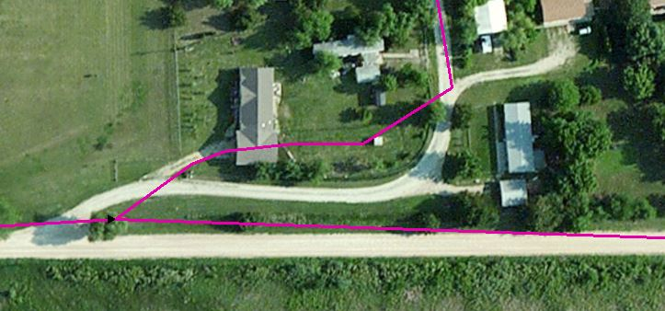
Fails to Meet Standard

Slide 22
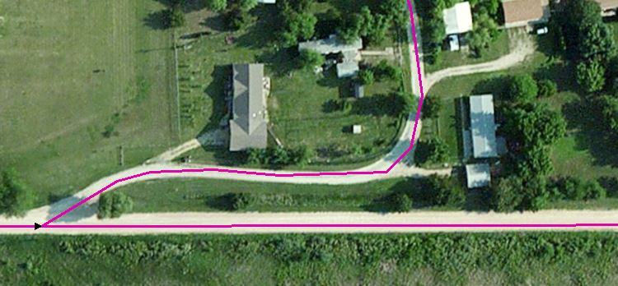
Meets Minimum Standard

Slide 23
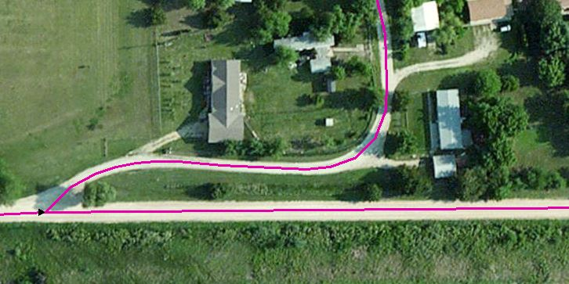
Meets Recommended Standard
Road segments created during grant-funded remediation must meet this standard.

Slide 24
Road Centerlines – Document Review
Attributes
Special cases in geometry
Summary of standards

Slide 25
Road Alias Table
The Name field [RD] in the Road Centerline data must be the name used by the local addressing authority, even if that is not the most common name for a segment
All State and Federal Highway designations must be in the table
Any other common or uncommon name for the road segment may be in the table

Slide 26
Address Points
All structures and sites with an assigned street address
One point per occupancy (apartment, lot, store, camp site, etc)
Points must be on the structure or site they represent , but remember to keep call routing in mind

Slide 27
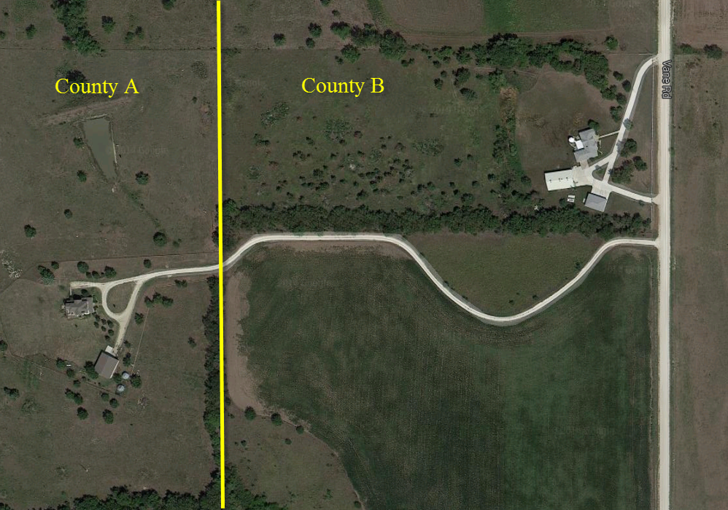

Slide 28
Authoritative Boundaries
Polygons that represent the geographic area for which the data is authoritative
The PSAP service area
Usually a county boundary or a city limit boundary

Slide 29
ESBs and ESZs
Emergency Service Boundary
  Polygon representing service areas for emergency service agencies.
  PSAP, Law enforcement, Fire and EMS at a minimum, but could also include others like First Responders, Rescue, Special Tactical Units
Emergency Service Zone
  The area related to a particular ESN or Emergency Service Number
  Should be the geometric union of law enforcement, fire and EMS service polygons

Slide 30
ESBs and ESZs: Why we need both
The ESN and ESZ will eventually be obsolete, but they are very important today
ESBs can represent more emergency service agencies and NG9-1-1 will be able to relay that information to call-takers

Slide 31
Topology for ESBs and ESZs
Each Emergency Service Boundary layer must fill the Authoritative Boundary polygons completely with no gaps and no overlaps
If a combined ESB layer is used, the PSAP, LAW, FIRE and EMS fields must be complete for every feature
The Emergency Service Zone layer must fill the Authoritative Boundary polygons completely with no gaps and no overlaps

Slide 32
Grant-funded Remediation
Phase 1: Road Centerlines, Road Alias Table, Address Points, Authoritative Boundaries, Emergency Service Boundaries, Emergency Service Zones
Phase 2: Cell Sites and Sectors, Emergency Service Agency Locations, Municipality Boundaries, Municipality Divisions, Neighborhoods, Counties and States

Slide 33
What will grant money pay for in Phase 1?
Correcting all Phase 1 data layers for proper placement, topology and attribution
Creating the features needed to complete the Phase 1 data layers

Slide 34
What can get created with funding?
Road Centerlines
  Public Roads
  Addressed Private Roads
Road Alias Table
  Highways
  Anything provided by the PSAP
Address Points
  The “primary” point for any addressed structure or site
ABs, ESBs, ESNs
  Any needed feature

Slide 35
What will not be funded?
CAMA correction
Centerlines for driveways and other private roads that are not addressed
Features outside the Authoritative Boundary polygons
Travel or research time for populating attributes or records considered optional

Slide 36
Thank you
GIS Subcommittee
Kansas 911 Coordinating Council

