Slide 1

NG911 GIS User Group
2017 Q2 Webinar
May 18, 2017
2:00 – 3:00pm
https://www.startmeeting.com/wall/857-952-052
701-801-1211
Meeting ID: 857-952-052

Slide 2
NG911 GIS User Group
Purpose: Outreach and coordination effort to discuss and update users on NG911 GIS related project topics
Quarterly webinars
Meeting/social at KAM Conference
NG911 Data Stewards & Data Maintainers

Slide 3
NG911 GIS User Group
Agenda
2:00 - 2:15 pm - NG911 Project Update
2:15 - 2:35 pm – MSAG/GeoMSAG update & GIS Committee Activities
2:35 – 2:45 pm - NG911 GIS Toolbox
2:45 – 2:55 pm - NG911 Program Portal
2:55 – 3:00 pm – Announcements & next webinar

Slide 4
NG911 GIS User Group
Project Update
2017 Q1 Submissions – 100%
Oklahoma/Kansas NG911 GIS Summit
Imagery Refresh Plan

Slide 5
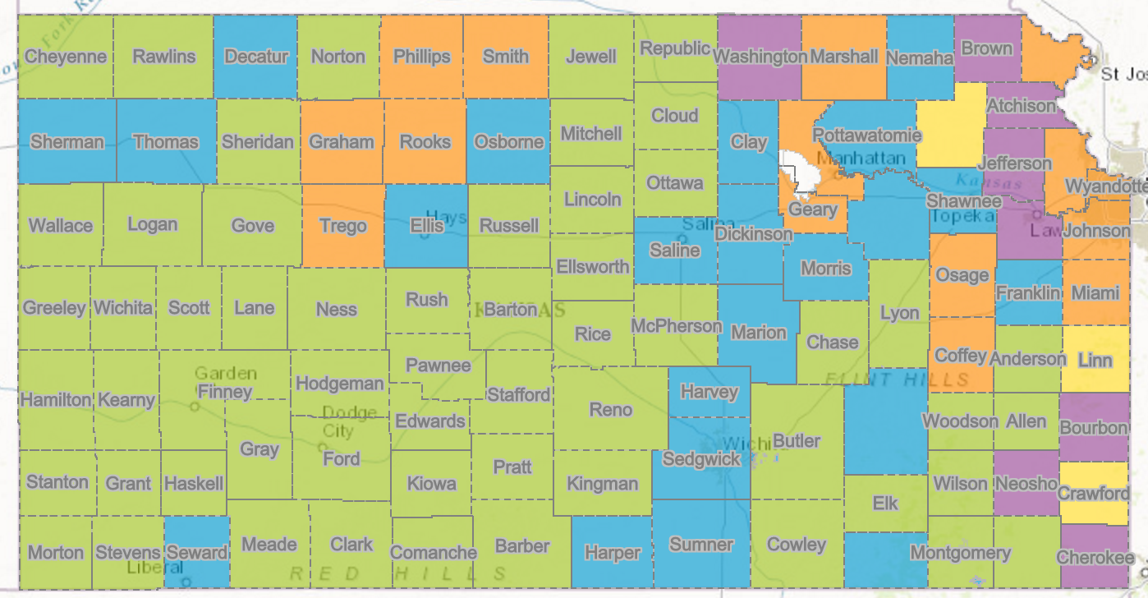
NG911 GIS User Group
Hosted Solution Deployment Status Map

Slide 6
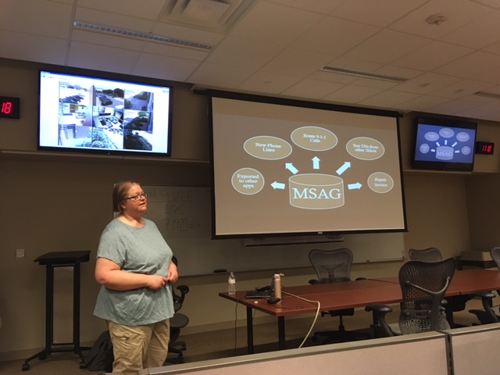
NG911 GIS User Group
2017 Training dates
Garden City - June 20
Hays – July 19
Iola – July 25
Lawrence – August 16
Manhattan – date TBD, late August
KAM Conference
  Data Maintainer only - October

Slide 7
MSAG
Route 9-1-1 Calls
Test TNs from other Telcos
New Phone Lines
Repair
Service
Exported to other apps

Slide 8
GIS
Route 9-1-1 Calls
Test TNs from other Telcos
New Phone Lines
Repair
Service
Exported to other apps
geoMSAG
GIS

Slide 9
KS NG9-1-1 GIS Data Model Changes
CORs come in throughout the year
GIS Committee discusses then votes on any proposed changes once per year (spring/summer)
Approved changes are sent to Data Maintainers and then the public at large for review and comment
The new Data Model document, template geodatabases, and update scripts are created
Stewards and Maintainers are notified by email
All submissions must be in the new version by the third quarterly deadline after it is released

Slide 10
Toolbox Updates
Several minor changes in toolbox
Tools all compatible with ArcGIS 10.5
  Geocode Address Points
  Check TN List/Geocode TN List
You can use, but methods will be changing

Slide 11
Moving Forward
Esri geocoding changes with each version
  Inconsistent results
For NG911, need consistency
Migrating to direct data comparisons
  Overlapping address ranges
  Address pt & TN list to road centerline
  These can take a while to run

Slide 12
Looking ahead
Next geodatabase model
Tools to assist with conversion
Auto-populate new attributes

Slide 13
NG911 GIS User Group
Next NG911 GIS Data submission deadline
  June 30, 2017
Next NG911 GIS User Group webinar
  August, 2017

Slide 14
NG911 GIS User Group
Thank you!
Kansas 911 Coordinating Council website
http://www.kansas911.org/
DASC - Initiatives>NG911
http://www.kansasgis.org/initiatives/NG911/

