Slide 1

NG911 GIS User Group
2017 Q1 Webinar
February 23, 2017
10:00am - 11:30am
https://global.gotomeeting.com/join/708092925
641-715-3395
Participant code: 1054194

Slide 2
NG911 GIS User Group
Purpose: Outreach and coordination effort to discuss and update users on NG911 GIS related project topics
Quarterly meetings or webinars
Meeting/social at KAM Conference
NG911 Data Stewards & Data Maintainers

Slide 3
NG911 GIS User Group
Agenda
10:00 - 10:20 am - NG911 PROJECT UPDATE
10:20 - 10:40 am - PREPARING GIS DATA FOR GEOSPATIAL CALL ROUTING
10:40 - 11:00 am - NG911 GIS TOOLBOX
11:00 - 11:10 am - NG911 PROGRAM PORTAL
11:10 - 11:20 am - ANNOUNCEMENTS & NEXT MEETING

Slide 4
NG911 GIS User Group
Project Update
2016 Q4 Submissions
Nebraska/Kansas NG911 GIS Summit
Imagery Refresh Plan
Hosted Solution Status Map

Slide 5
Preparing GIS Data for Geospatial Call Routing

Slide 6
Step 1:
Keep the GIS data current

Slide 7
Step 2:
Make sure all TN addresses geocode successfully

Slide 8
The “To Do” List
Review your GIS/MSAG Alignment Report
Work the problems using the instructions included with the report until you don’t have any more problems
If you aren’t friends with your MSAG Coordinator, work on that

Slide 9
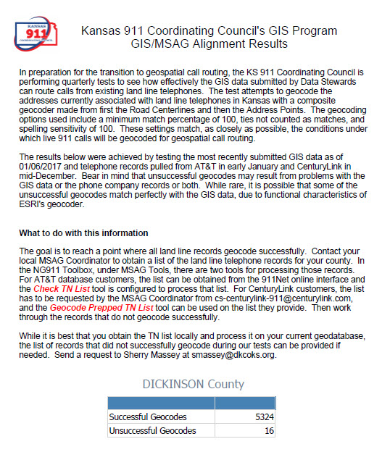

Slide 10
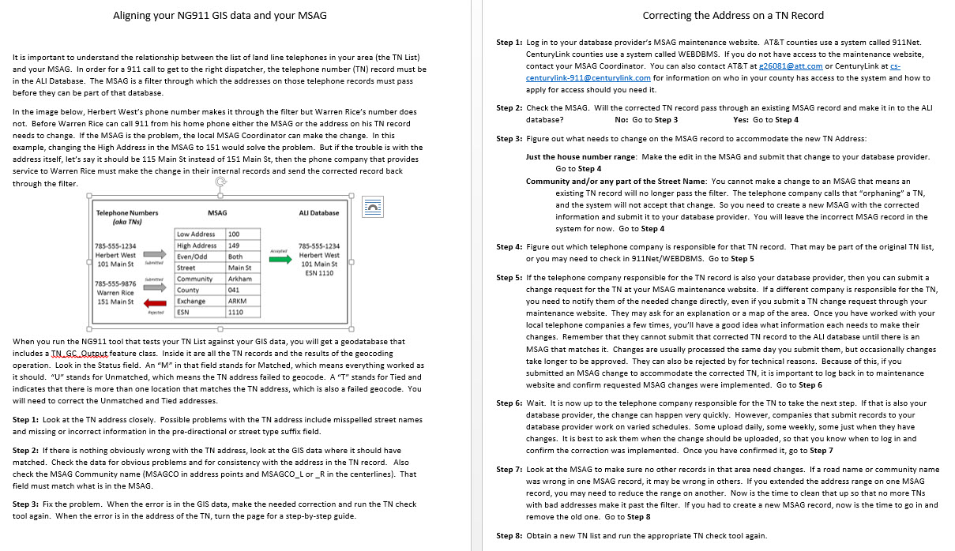

Slide 11
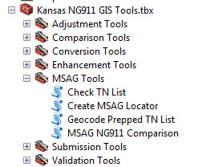
MSAG Tools in the NG911 Toolbox

Slide 12
How long do I have to get this done?
Group 1: Allen, Anderson, Barber, Barton, Chase, Cheyenne, Cloud, Clark, Comanche, Cowley, Edwards, Elk, Ellsworth, Ford, Grant, Gray, Greeley, Hamilton, Haskell, Hodgeman, Jewell, Kearny, Kiowa, Lane, Lincoln, Lyon, McPherson, Meade, Mitchell, Montgomery, Morton, Ness, Norton, Pawnee, Pratt, Rawlins, Reno, Republic, Rice, Rush, Russell, Scott, Sheridan, Stanton, Stevens, Trego, Wallace, Wichita, Woodson
Group 2: Butler, Chautauqua, Clay, Decatur, Dickinson, Ellis, Finney, Franklin, Greenwood, Harper, Harvey, Kingman, Labette, Logan-Gove, Marion, Morris, Nemaha, Osborne, Ottawa, Saline, Sedgwick, Seward, Shawnee, Sherman, Sumner, Thomas, Wabaunsee, Wilson
Group 3: Everyone Else

Slide 13
Step 3:
Replace the MSAG with a GIS-derived MSAG

Slide 14
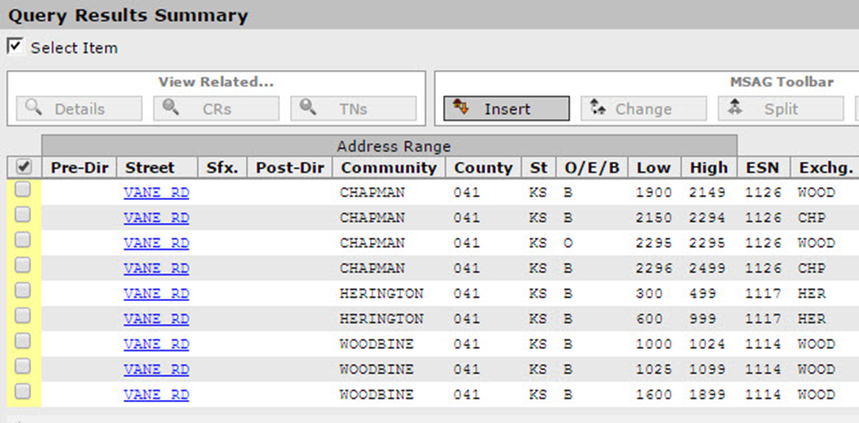
The MSAG

Slide 15
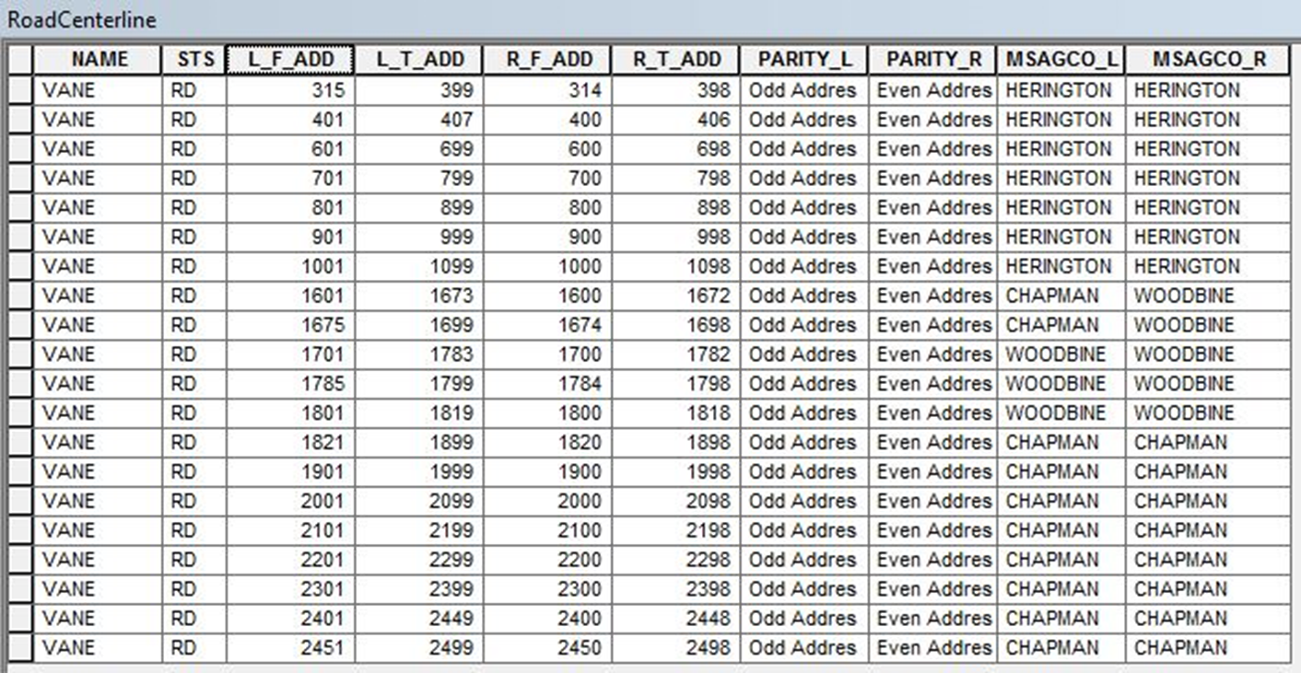
The Road Centerline Feature Class

Slide 16
GIS-derived MSAG (geoMSAG)

Slide 17
Step 4:
Keep everything updated

Slide 18
NG911 Toolbox Update
Kristen Jordan Koenig
kristen@kgs.ku.edu

Slide 19
Submitting Supporting Data Layers
New layers in 2.0: gates, hydrants & parcels
Compatible with validation tools
Parcels- for NG911, we won’t share
Parcel lines, show up in dispatcher map
Easy migration & updates
  Tool in “Conversion Tools”: Add/Update Parcel Layer
  Automatically brings in parcels in NG911 format

Slide 20
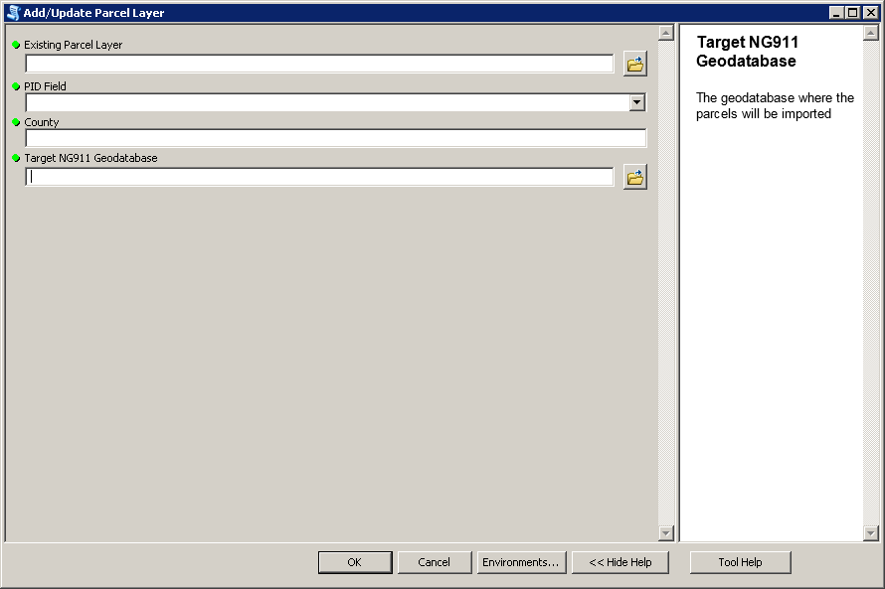

Slide 21
Tools for Geospatial Call Routing
Validation Tools: new messages
  Notice: Overlapping addresses
  Notice: Road segment contains address for area outside PSAP boundary
Targeted towards geospatial call routing
Goal- no geocoding ties, even on statewide level
All Validation checks support NG911 data model

Slide 22
Tools for Geospatial Call Routing
Enhancement Tools- Compare Road Names
Compares road names in address points and road centerline
Encouraged to run this quarter
Data quality check- do you have consistent road names?

Slide 23
Tools for Geospatial Call Routing
MSAG Tools- Check TN List & Geocode Prepped TN List
Verify existing TN List geocodes to NG911 data
Which tool you run depends on provider
Getting the TN List is the hardest part
More details- documentation in Doc folder of toolbox or see YouTube
  MSAGTools & Download_TN_records_from_911NET

Slide 24



Slide 25
NG911 Toolbox on YouTube
Channel: KS 911 Coordinating Council GIS Committee
New series: Toolbox Time
2 training videos so far
  Compare Road Names (7 min)
  TN List Tools (23 min)
Search YouTube for NG911 toolbox
Email me if you want videos about other tools

Slide 26
NG911 Program Portal
Data Request
Email notifications
Keep contact information updated!

Slide 27
NG911 GIS User Group
Next NG911 GIS Data submission deadline
  MARCH 31, 2017
2017 NG911 GIS Steward & Maintainer Training
  Spring/Summer timeline, dates coming soon
Next NG911 GIS User Group webinar
  May, 2017

Slide 28
NG911 GIS User Group
Thank you!
Kansas 911 Coordinating Council website
http://www.kansas911.org/
DASC - Initiatives>NG911
http://www.kansasgis.org/initiatives/NG911/

