Slide 1
PSAP Launch March 11, 2015 Crisis City, Kansas
Statewide NG9-1-1

Slide 2
1000 Welcome
1020 Coordinating Council Update
1040 Deployment Strategy and Plan
1100 System Description
1120 Training Strategy and Plan
1140 GIS Committee Update
1200 Catered Lunch
1300 Call Handling Solution and Spares
1340 Project Plan and Change Control
1400 Site Survey and Site Conditioning
1420 Cost and Administration
1500 Adjourn
Scott Ekberg, NG9-1-1 Administrator
Walt Way, Chair 9-1-1 Coordinating Council
Scott Ekberg
Jay Coverdale, Chair Technical Committee
Michele Abbott, Chair Operations Committee
Ken Nelson, Chair GIS Committee
On Site
Phillip Ryan, Area Manager E911, AT&T
Randall White, Program Manager, Council
Randall White for Mike Ball, PM, AT&T
Scott Ekberg
Agenda

Slide 3
Welcome (Scott ekberg)
Infrastructure and GIS Contract Background
GIS Data Gap Analysis – AOS
GIS Data Remediation – ACTi, GeoComm, GDR, Kimble Mapping, R&S Digital
GIS Quality Assurance Audit – AOS
Orthoimagery - SURDEX
Infrastructure and Statewide Call Handling – AT&T
Solution as a Service includes technology refresh, full support, training, maintenance
Where we are as compared to the rest of the nation

Slide 4
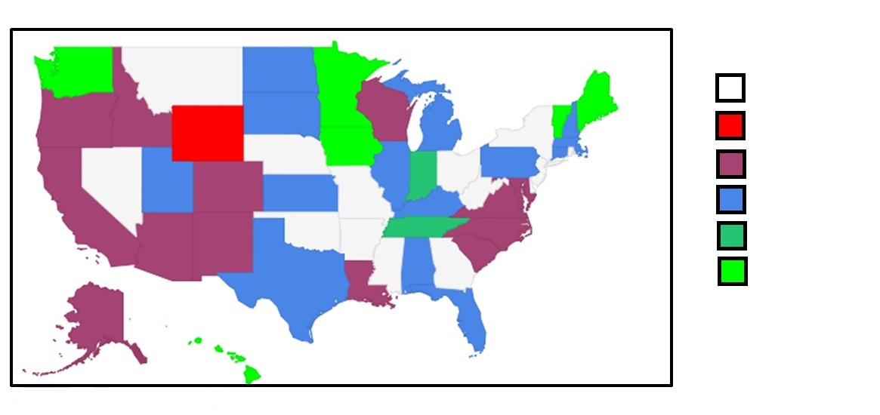
NG911 Progress Nationally
= No Response
= No Progress
= Planning/ Consultation
= In Progress
= Some 911 Calls delivered via ESINet
= All 911 calls delivered via ESINet

Slide 5
Coordinating council update (Walt way)
Kansas Statewide Next Generation 9-1-1

Slide 6
background
911 Coordinating Council was created by the 911 Act of 2011
has 26 members: 22 are appointed by the Governor, 4 are appointed by legislative leadership
All Council members are volunteers who represent
PSAPs
IT
GIS
TAG
telecommunications providers
law enforcement
Fire and EMS
other stakeholder groups

Slide 7
Council has broad statutory responsibilities
monitoring the delivery of 911 services in the state
developing strategies for future enhancements to the 911 system
distribution of 911 state grant funds
adoption of administrative regulations
selection of the Local Collection Point Administrator (LCPA)
providing guidance to 117 Public Safety Answering Points (PSAPs) in Kansas

Slide 8
The 911 act
Establishes common fee of $.53 per month per communications device capable of calling 911
Establishes a prepaid wireless 911 fee of 1.06% per retail transaction
Establishes restrictions as to how 911 funds may be expended by PSAPs in the course of providing 911 service in their jurisdictions
Directs that 911 state grant funds administered by the Council should be expended on
Projects for the implementation of Next Generation 911 services
Cost sharing and PSAP consolidation projects
Expenses related to the Council, and for audits of the 911 system

Slide 9
The 911 act (cont.)
Provides for each county to receive a minimum of $50,000 per year in 911 revenue so that PSAPs across the state would have the base funding needed to provide for an equitable level of 911 service
In 2014, the number of Counties receiving additional 911 revenues to reach the $50,000 annual revenue minimum totaled 55 out of the 105 counties

Slide 10
Building blocks of NG911 System
Shared GIS database that meets national data standards
Emergency Services IP Network (ESInet) that transports the 911 calls, associated data, images, video to a PSAP as well as to emergency responders
digital call handling equipment in PSAPs to receive NG911 calls and associated information
network management and security services required to reliably transmit 911 calls to the appropriate destination within the network
(Subsequent speakers provide details)

Slide 11
Accomplishments of the council
Development of technical/operational requirements for specifications
Development of training standards for PSAP personnel
Maintained active financial oversight of PSAP expenditures
Awarded GIS Data Enhancement Project that benefits all 117 PSAPs in the state and is budgeted at $3,000,000 to be paid from 911 State Grant Funds
Awarded statewide aerial imagery project needed to accurately locate buildings and other structures in the GIS database contracted on a 3 year lease for $618,000 year, and allows for such imagery to be made available at no charge to any state and local government agency

Slide 12
Accomplishments of the council (cont.)
Award NG911 Infrastructure contract to AT&T
Adopted “State of Kansas Hosted Call Handling Value Statements” for funding/coordination NG911
Adopted several policy statements
How 911 State Grant Funds pay for the start-up costs and monthly reoccurring of the NG911 data centers and network infrastructure during the term of the contract with AT&T
How 911 Grant Funds to pay for the start-up CPE costs of PSAPs joining the statewide network with the provisions to be established for the number of 911 workstations funded by the Council
Adopted the PSAP cost share model (discussed later)
Approved the GIS Governance Policy
Approved the development of an Administrative Regulation to increase the 911 Fee to $.60

Slide 13
Infrastructure
Award
Feb 26,
2015

Slide 14
PSAP implementation plan (Scott Ekberg)
Kansas Statewide Next Generation 9-1-1

Slide 15
Deployment Strategy
Accumulated Total Number of PSAPs
29 transition from legacy 9-1-1
58 transition from legacy 9-1-1
87 possible transition to geo-spatial routing
117 possible transition to i3 architecture
Year
2015
2016
2017
2018

Slide 16
Reno 5 (Pilot)
Cowley 4 (Pilot)
Lane 2
Sheridan 1
Rush 1
Grant 1
Wallace 2
Mitchell 2
Cheyenne 2
Crawford 3
Gray 1
Greeley 2
Hamilton 1
Haskell 2
Hodgeman 3
Jewell 1
Kearny 1
Kiowa 1
Larned PD 1
Lincoln 1
Meade 1
Morton 1
Norton 1
Phillips 1
Pittsburg 3
Rawlins 2
Scott 1
Stanton 1
Stevens 1
Trego 2
Wichita 1
Wilson 2

Slide 17
Infrastructure (Jay Coverdale)
Kansas Statewide Next Generation 9-1-1

Slide 18
Infrastructure
NG911 System
Data Centers
Network
NMM
Call Handling
GIS Integration
Core Network
Regional Networks
Basic Package
Options
Includes Backup Network: LTE wireless or p-t-p T1

Slide 19
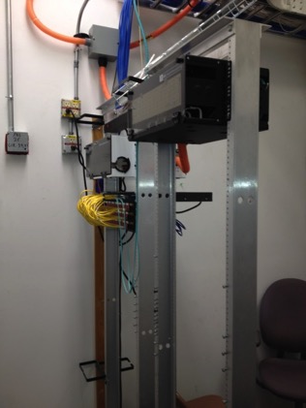
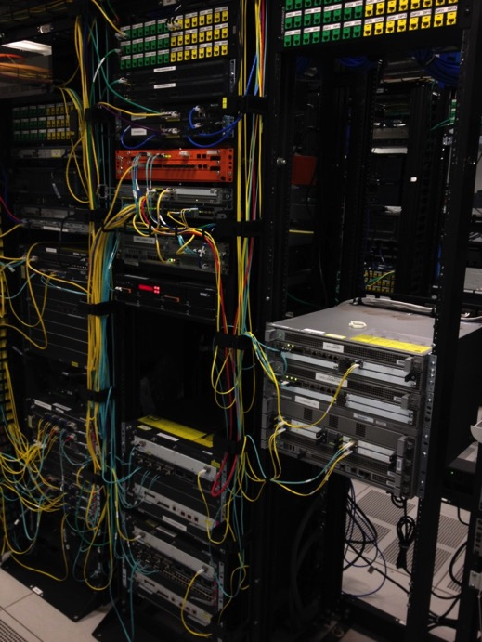
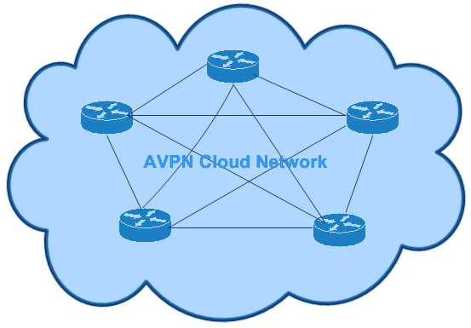
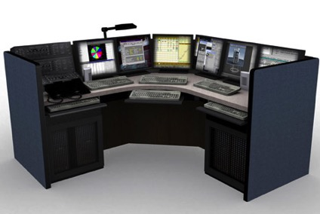
PSAPs
PSAPs
PSAPs
Data Center
Fiber
T1’s
Wireless
Data Center
PSAPs
PSAPs

Slide 20
NG911 training (Michele Abbott)
Kansas Statewide Next Generation 9-1-1

Slide 21
Training plan - it is a big deal
APCO Demo Room, Apr 27-29
NG911 Training Strategy and Plan
Initial PSAP Training
Regional Training (annual APCO’s)
Refresher Training (classroom, on-line)
CPE, Airbus, ECaTS
VESTA 911 Agent Training
VESTA 911 Admin Training
ECaTS MIS Training
Orion Vela Agent Training - Optional
Orion Vela Admin Training - Optional
Orion DataSync Admin Training - Optional

Slide 22
Training plan – APCO, Apr 27-29
APCO Demo Room, Apr 27-29
Administrators Round Table
Kim Pennington/Michele Abbott/Scott Ekberg
Council Meeting
Committee Meetings
Holiday Inn Manhattan
1641 Anderson Ave, Manhattan
(directly across from the KSU campus)

Slide 23
Training plan – initial PSAP training
Initial PSAP Training at Install
Admin
Mapping
Agent - call taker
CPE, Airbus, ECaTS
VESTA 911 Agent Training
VESTA 911 Admin Training
ECaTS MIS Training
Orion Vela Agent Training - Optional
Orion Vela Admin Training - Optional
Orion DataSync Admin Training - Optional

Slide 24
Training plan – regional training
Regional Training (annual APCO’s)
Airbus
ECaTS (web based option)
CPE, Airbus, ECaTS
VESTA 911 Agent Training
VESTA 911 Admin Training
ECaTS MIS Training
Orion Vela Agent Training - Optional
Orion Vela Admin Training - Optional
Orion DataSync Admin Training - Optional

Slide 25
Training plan – as psap comes on line
As PSAP comes on line
Use space at other agencies as they come online
Ensure new directors have access to admin training
New Hires have consistent training
CPE, Airbus, ECaTS
VESTA 911 Agent Training
VESTA 911 Admin Training
ECaTS MIS Training
Orion Vela Agent Training - Optional
Orion Vela Admin Training - Optional
Orion DataSync Admin Training - Optional

Slide 26
Michele Abbott, Operations Committee Chair Michele.abbott@renolec.com 620-694-2806
Questions?

Slide 27
The GIS Connection (ken Nelson)
Kansas Statewide Next Generation 9-1-1

Slide 28
Geographic Information System
GIS data remediation project
GIS standards & policies
Statewide high-resolution imagery
GIS data aggregation & ongoing maintenance
Next steps

Slide 29
Why are we HERE...WE, as in THE GIS PEOPLE
NG9-1-1 (geospatial call routing) requires GIS data that is both accurate and current in order to function.
We intended to have the data ready when the 911 Coordinating Council implements this phase of the project.
“Geospatial call routing is NOT theoretical, it’s going to happen, you’re on the right path, and PLEASE do not slow down.”
Chuck Ronshagen, Airbus DS Communications (formerly Cassidian Communications)

Slide 30
Primary goal
Provide GIS data that will support:
geospatial call routing and
Vela Map display

Slide 31
Gis data requirements
Statewide…covering every county and PSAP
Consistent…common set of data layers, data model and implementation procedures (address points, road centerline, emergency service boundaries)
Current…regularly maintained
Authoritative…accurate and reliable
Standardized…Meets applicable Kansas & NENA NG911 GIS Standards, Data Models and Implementation Guidelines

Slide 32
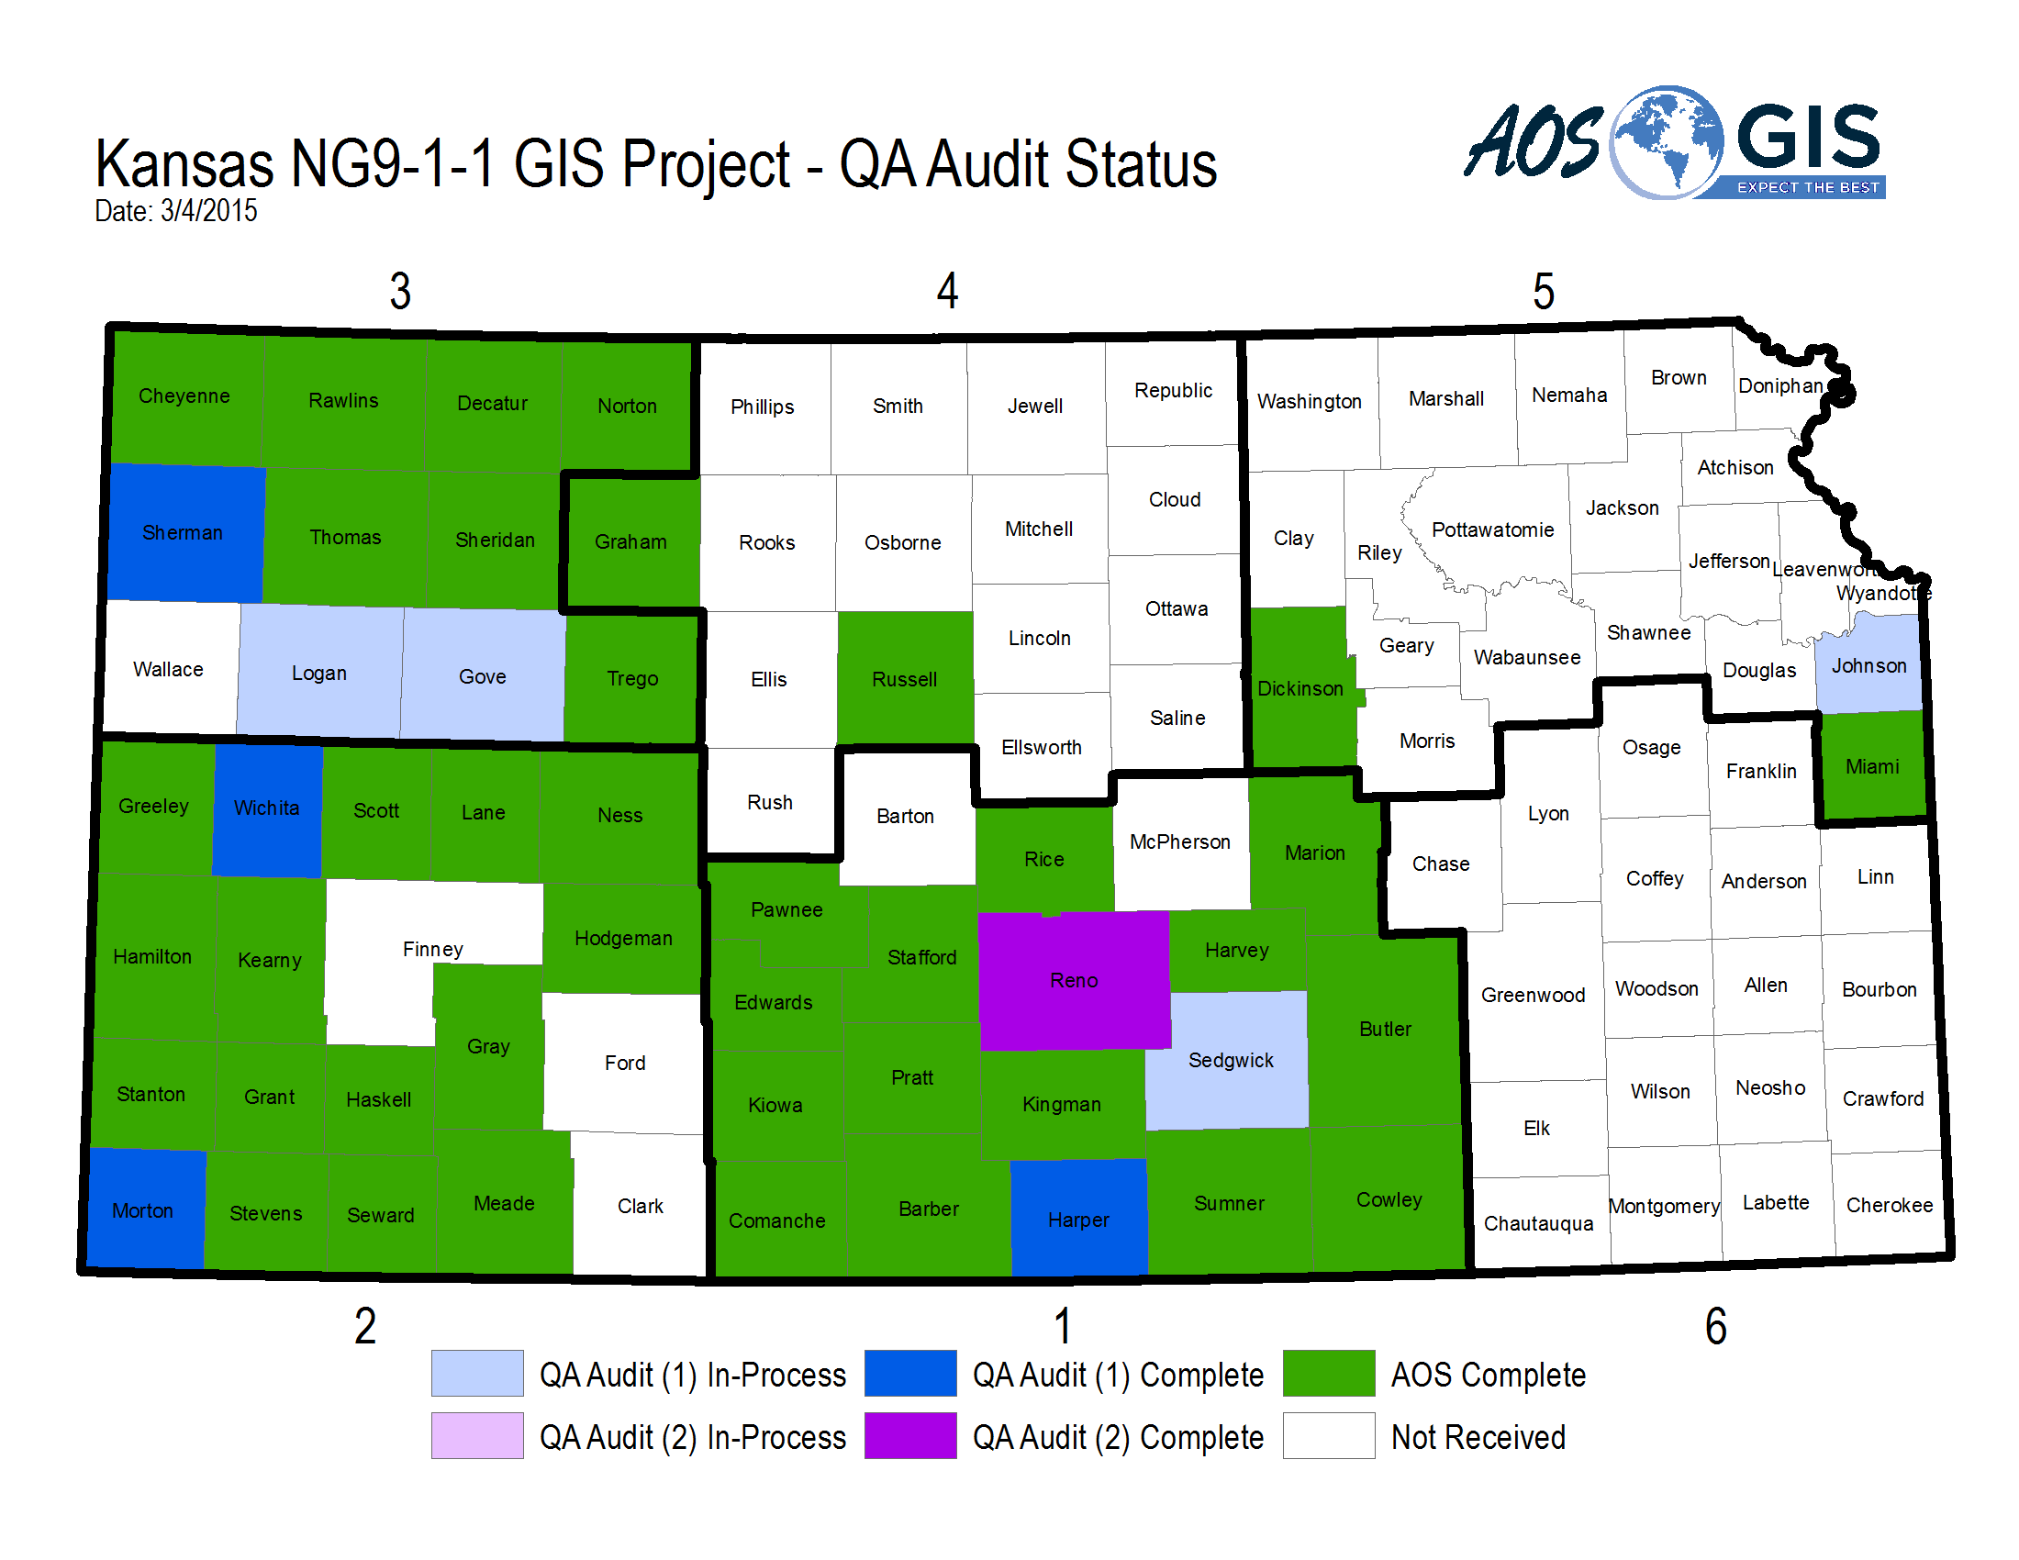
Gis gap analysis and data remediation
Three step process:
GIS Data Gap Analysis (Project A – complete statewide)
Determine how existing data adheres to new standard…aka…the “Gap”
Performed by AOS
GIS Data Remediation (Project B - in-progress)
Remediate data to Kansas NG9-1-1 GIS Data Model
Performed by jurisdiction or one of the following vendors
ATCi
GDR
GeoComm
Kimble Mapping
R&S Digital
GIS Data QA Audit (Project C – 46 counties have submitted data for QA)
Ensure all issues were remediated according to the standard (100% compliance)
QA audit performed by AOS

Slide 33
Kansas nG911 GIS Data Model
Developed to provide a framework for consistent statewide data and help jurisdictions meet NENA requirements
Adheres to NENA GIS specifications and expands to add value for state purposes
Esri file geodatabase templates have been developed by GIS Committee and used by PSAPs for data submission
NG9-1-1 GIS Toolbox contains validation scripts and conversion tools to support geodatabase template users
GIS Data Model and ongoing maintenance training

Slide 34
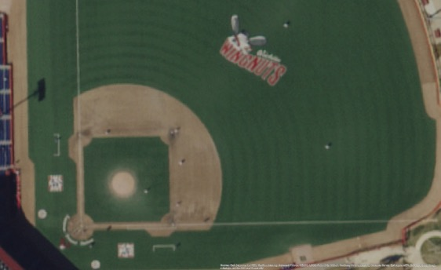
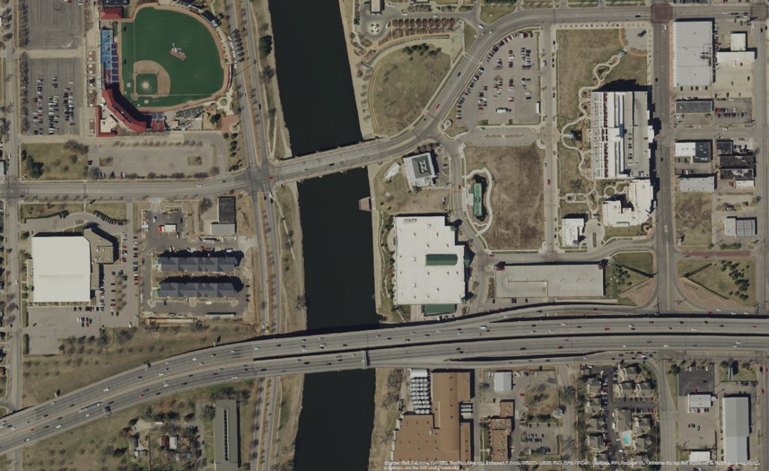
Statewide Orthoimagery
Goal – ensure jurisdictions have access to a current, consistent, statewide, high-resolution imagery basemap to support data remediation.
Statewide, 1-foot pixel resolution, natural color, orthoimagery
License allows access to the following
State, county, and municipal (city) government agencies/department
Regents institutions
All Public School Districts
Any firm doing work on behalf of one of these entities
No public domain distribution
Formats: GeoTIFF, MrSID compressed Web Map Service
Vendors
Imagery – Surdex Corporation
Web Services – Valtus
Access
DASC provide distribution services
See www.kansasgis.org or kansas911.org for more details

Slide 35
GIS Data Aggregation
Process by which individual county geodatabases are stitched together to form the statewide geodatabase
Current status
RFP released through KDOT
Develops initial data aggregation methodology to create seamless database from individual county/PSAP databases
Opportunity for KDOT to leverage high-quality NG9-1-1 road centerline data
Opportunity for local jurisdictions to receive for additional attribute information/business data maintained by KDOT

Slide 36
Gis subcommittee
Work with selected vendors on the GIS Data Gap Analysis & Remediation
Document business needs and RFP specifications
Develop Kansas NG9-1-1 GIS Data Model to support data remediation and ongoing maintenance activities
Develop and recommend data aggregation & maintenance strategies for statewide master repository
Chairman
Ken Nelson
NG911 Administrator
Scott Ekberg
DASC
Eileen Battles
Co-chair
Sherry Massey
Ellis County
Eamonn Coveney
KDOT
Kyle Gonterwitz
Dickinson Co
Sherry Massey
Sedgwick Co
John Rogers
Johnson Co
Keith Shaw
Johnson Co
Mark Whelan
MARC
Saralyn Hayes
Coordinate with training committee to develop a training program that supports the operation and maintenance of the NG9-1-1 GIS components
Develop other GIS-related policy documents –Governance Policy, Change Management Policy…

Slide 37
Next steps
Complete GIS data remediation project
We’re making great progress, but we’ve got a ways to go. Timeline for completion = July, 2015.
Ensure ongoing maintenance
Support KDOT’s Data Aggregation & Conflation project
Facilitate communication between vendor and local jurisdiction as necessary
Provide technical support related to Kansas NG9-1-1 GIS Data Model or other related policies
Develop data synchronization workflow to support Vela Map display
Develop project implementation plan
Research geospatial call routing software solutions, recommend next steps to Council
Timeline for implementation is 2-3 years out
Examine options for 3rd party Spatial Interface Function (SIF)
Determine requirements

Slide 38
Call Handling solution (Phillip ryan)
Kansas Statewide Next Generation 9-1-1

Slide 39
Call Handling Solution
Basic Equipment Suite: how is it the same? How is it different?
Optional Equipment Suite: what will it do for you?
Day-2 Support AT&T 9-1-1 Resolution Center: same / better that you are accustomed to
Spare and Logistic Support: strategic storage for High Availability

Slide 40
Call Handling Package and Options
Basic Package*
Options* added cost
Computer workstation with monitor
Mouse and keyboard
Audio interface
4 port gateway for admin lines
Cables and Ethernet cable
Network printer and associated cable
Robust networking equipment (switch, router…) primary and backup circuits included
ECaTS MIS and 24x7 Monitoring of Network
Maintenance is included
Automatic Call Distribution
Call Display Wall Boards
Dual power supply routers
* Single seat PSAPs include an enhanced IP phone (1/2 Station) for redundancy purposes.
These are available as options for 2+ seat PSAPs.

Slide 41
Project Plan (Randall White)
Kansas Statewide Next Generation 9-1-1

Slide 42
Project Plan
PSAPs Volunteer to Participate in Program
Prioritize PSAP Deployment
PSAP Consultation and Service Order
Site Survey Visit and Engineering Evaluation
PSAP Consultation if Engineering Changes
Final Equipment Order
PSAP Equipment Suite Staging and Burn-in
PSAP Site Conditioning and Readiness
PSAP Training
Circuit Installation, Turn-up, Soak
Tiger Team Equip, Install, Test and Turn-up
PSAP Partial Acceptance (Day-0)
PSAP Go Live and Full Acceptance (Day-10)
Resolution Center Support
Change Management Control

Slide 43
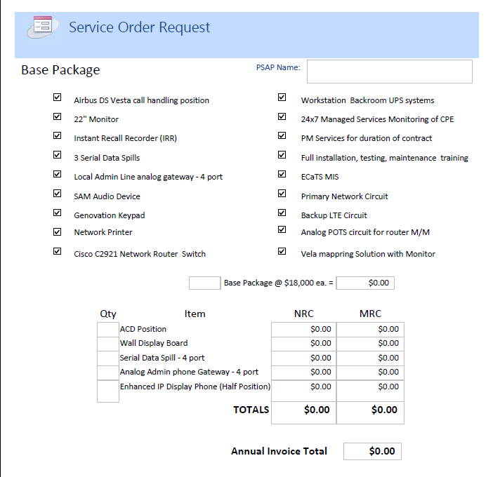
Service Order request

Slide 44
Typical Site Survey
Local Contacts
GIS Coordinator
PSAP Positions Description
PSAP Bill of Material (Service Order)
Local Exchange Carrier (LEC) Connectivity
MSAG / ALI Databases
TDD / TTY Integration
Equipment Room Assessment
Telco Demarcation
LTE Wireless Backup Signal Strength or p-t-p T1
Support Systems
Administrative Phones
Radio Consoles
CAD
Mapping
Logging Recorder
ACD
Law Records
Corrections Records
Mobile Data

Slide 45
Site Conditioning
Based on Site Survey and Needs Analysis
PSAP Responsibility
A/C Power Capacity
HVAC Capacity
Telco Demarcation Minimum Point of Entry (MPoE)
Backboard 4’x4’ fire-resistant plywood sheet mounted
Earth ground at least 6AWG copper

Slide 46
Change Management: Stability and integrity
Oversight Committee: final authority if required
Change Advisory Board (CAB): informs all NG911 Committees
Committee Change Control Board (CCB): approves local changes
Change Manager: processes Change Order Request (COR)
Change Requestor: anyone may submit a change

Slide 47
Cost and administration (Scott ekberg)
Kansas Statewide Next Generation 9-1-1

Slide 48
Cost Recovery plan
Council pays non-recurring costs for Data Centers & PSAP Base Equipment Suite
Council pays recurring costs for core network & PSAP network/call handling
PSAPs pay flat fee of $18,000 per seat annually: generates reserve funds
Council increases the 911 Fee to 60¢

Slide 49
Cost Recovery Totals
 | Actual Total NRC | Actual Total MRC annual | Flat Rate of $18000 | Reserve Funds Generated
TOTALS | $6,918,240 | $4,858,652 | $6,264,000 | $1,405,348

Slide 50
Examples of Impact on Selected PSAPS
PSAP Name | # of Seats | Flat Fee @ $18,000/Seat | Estimated CAMA & ALI Costs | Annual Cost | Est. Revenue from 60¢ 911 Fee | 911 Fee Balance After Call Handling
Garden City PD | 6 | $108,000 | $44,800 | $152,800 | $179,268 | $26,468
Sedgwick Co | 24 | $432,000 | $332,750 | $764,750 | $2,671,943 | $1,907,193
Hutch/Reno | 4 | $72,000 | $77,200 | $149,200 | $333,696 | $184,496
Independence | 2 | $36,000 | $8,400 | $44,400 | $90,136 | $45,736
Wallace Co | 2 | $36,000 | $6,000 | $42,000 | $50,000 | $8,000
Woodson Co | 1 | $18,000 | $6,000 | $24,000 | $50,000 | $26,000

Slide 51
What about CAMA charges and ali fees
PSAP continues to pay CAMA trunk charges and ALI database fees as they do now
As PSAPs are brought onto the statewide system, CAMA trunk usage will be reevaluated to determine if fewer CAMA trunks can be used without affecting performance
Consultation with the PSAPs will occur before discontinuation of any CAMA trunks
CAMA and ALI charges end when geospatial routing is implemented late 2016 or early 2017. There may be connectivity charges for delivery of calls via SIP protocol at that time, but the extent of those charges is currently unknown.

Slide 52
Expectations of PSAPs
Regional Cooperation is encouraged to reduce Workstation Count / Cost
Reduces workstation count / cost
Increases regional interoperability
Improves NG911 information sharing

Slide 53
Memorandum of Understanding
POTS line for managed routers: may need assistance ordering outside of AT&T territory
Flat Fee: agreement to pay
Site Survey Visit and Service Order Request: determine local contacts
Site Conditioning: any remediation determined at Site Survey
Security Plan and Enforcement (physical and network): agreement to comply
Disposal of Legacy Equipment: as you have in the past

Slide 54
Next steps
Near Term
Future
PSAPs Volunteer to Participate
PSAP Consultation and Service Request
PSAP Site Survey and Engineering Evaluation
PSAP Training
Equipment Installation and Test
PSAP Go Live and Acceptance
Day-2 Resolution Support Center
Implement Text-to-911 via ESINet
Trunk-Side Recording
Implement Geospatial Call Routing
Implement Picture & Video Messaging via ESINet
Implement Telematics via ESINet
Implement additional i3 services as they develop
Neighboring States Collaboration Plan

Slide 55
Who Ya gonna call…
Scott Ekberg 785-438-8440 scott.ekberg@us.army.mil
Michele Abbott 620-694-2806 michele.abbott@renolec.com
Phillip Ryan 316-655-0347 phillip.ryan@att.com
Randall White 913-485-9911 randallwhite@kc.rr.com

Slide 56
Thank you for coming…
Please drive safely

