Slide 1
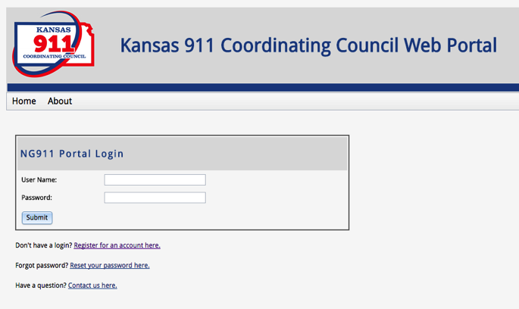
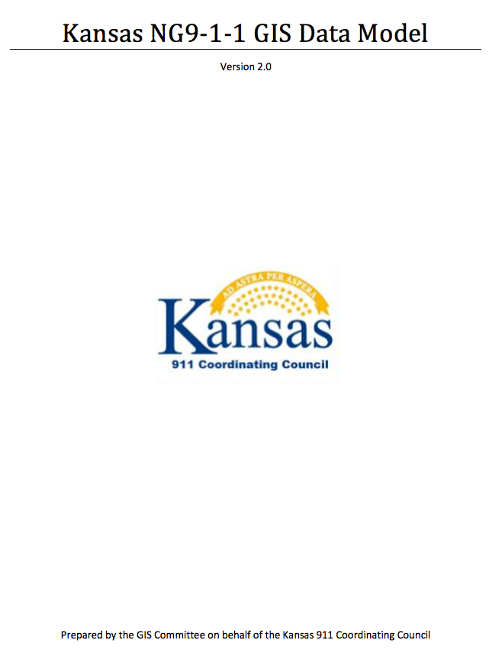
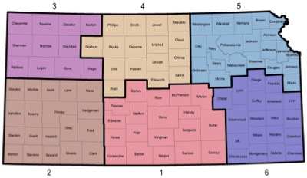
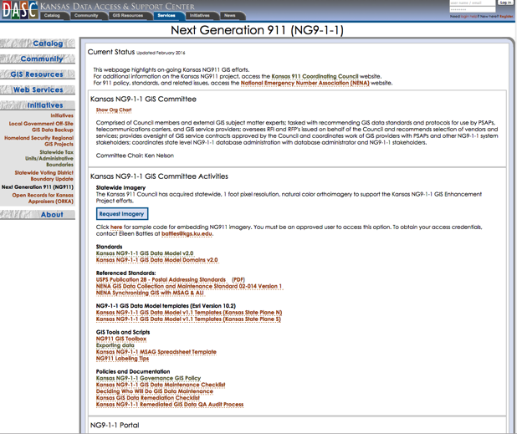
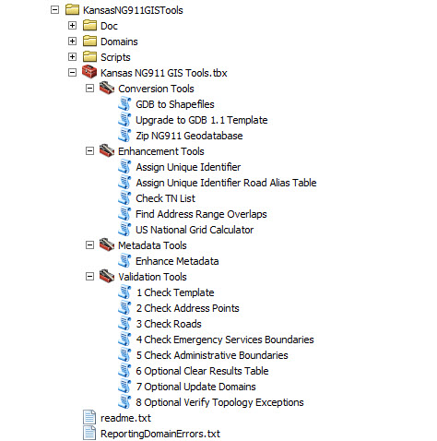
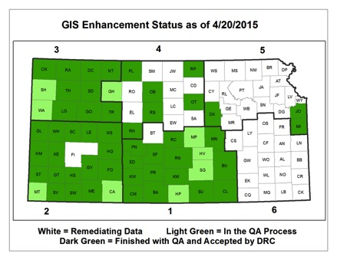
NG911 GIS User Group

Slide 2
NG911 GIS User Group
Led by GIS Committee
Quarterly (or as needed) conference calls
Meeting/social at annual KAM Conference
Purpose: Outreach and coordination effort to discuss and update users on NG911 GIS related project topics
NG911 Data Stewards & Data Maintainers
Portal: Documents, presentations, email list, etc.
DASC NG911 webpage: GIS related content, announcements, training registration, etc.

Slide 3
NG911 GIS User Group
GIS Data Remediation
Started in 2014
Completed September, 2016!
All 117 PSAPs passed Final QA
100% compliance with Kansas NG911 GIS Data Model
NG911 Statewide
Over 1.3 million address points
471,033 road segments

Slide 4
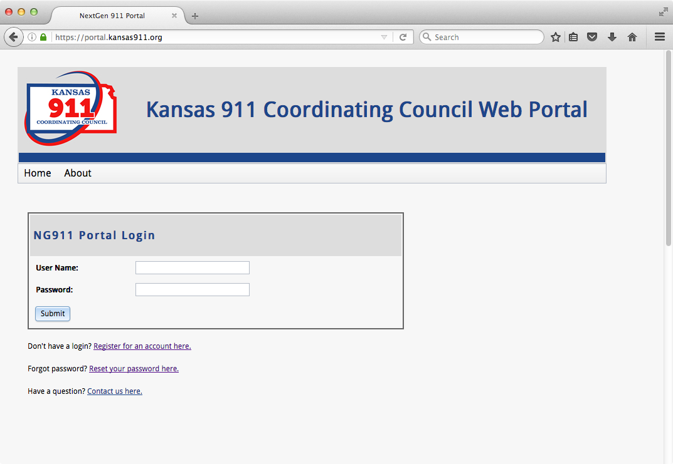
NG911 Portal and GIS Data Maintenance
GIS Data Maintenance
Submit GIS data updates on the NG911 Portal
Frequency
As needed
Quarterly (minimum)
Submission statistics
Over 300 submission
First submission
Oct 13, 2015

Slide 5
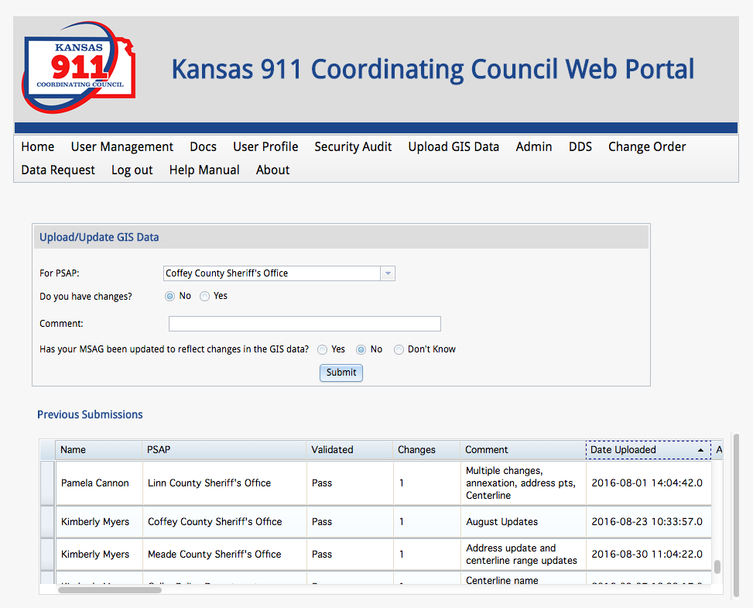
NG911 Portal
Please keep contact information current
View history of GIS submissions
Documents > GIS

Slide 6
How the KS NG911 Program Works
County A
NG911 Portal
Vesta Locate
Updated Data
County B
Master Repository
County C
Updated Data

Slide 7
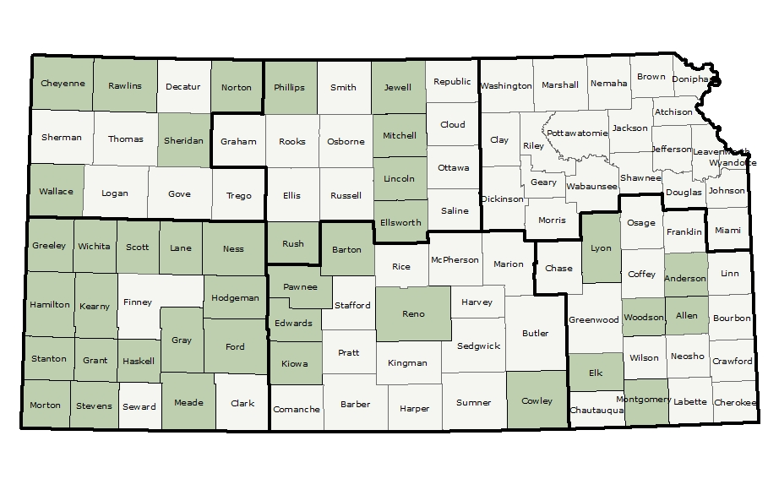
Kansas NG911 Hosted Solution
38 PSAPs/Counties on hosted solution

Slide 8
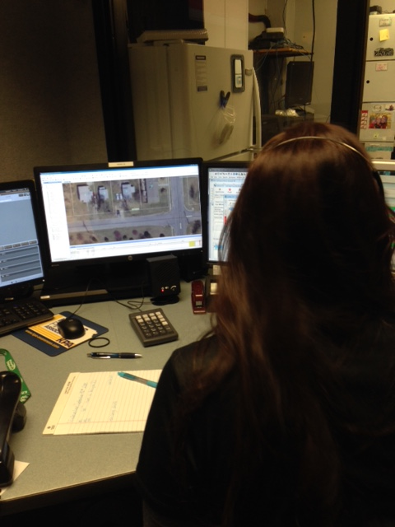
What is Vesta Locate?
Kansas NG911 Hosted Solution map interface for call handling
Includes a map that receives GIS data from a central server
Local or Central Map Administration
Part of Statewide 911 phone system
Over 70 counties have signed up and installations are progressing continually

Slide 9
What is Vesta Locate?

Slide 10
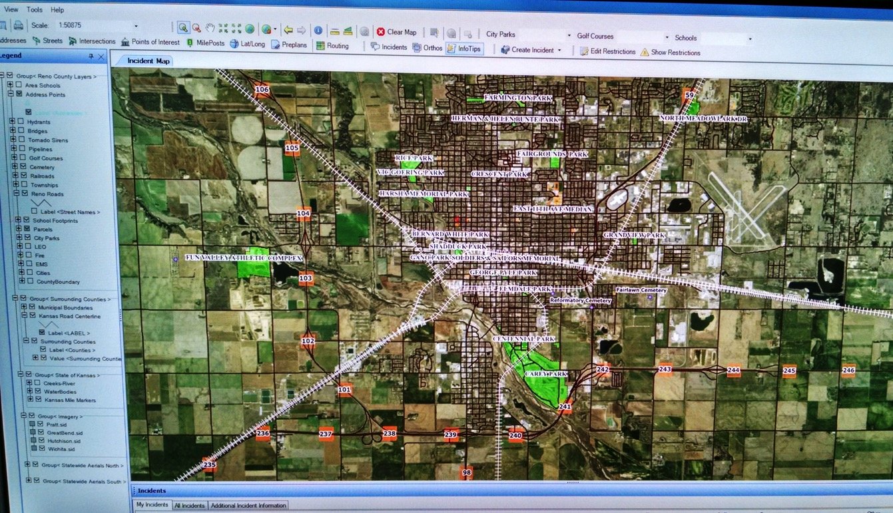
What is Vesta Locate?

Slide 11
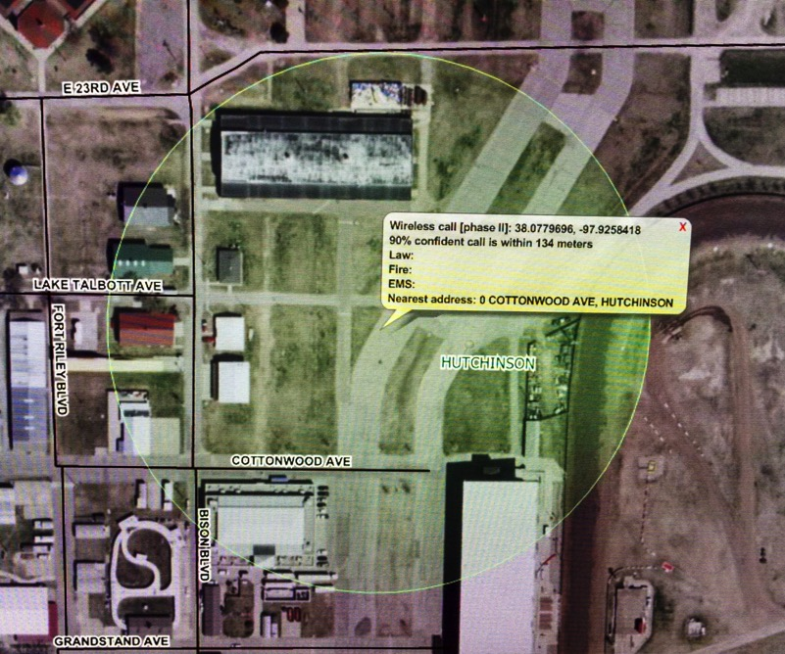
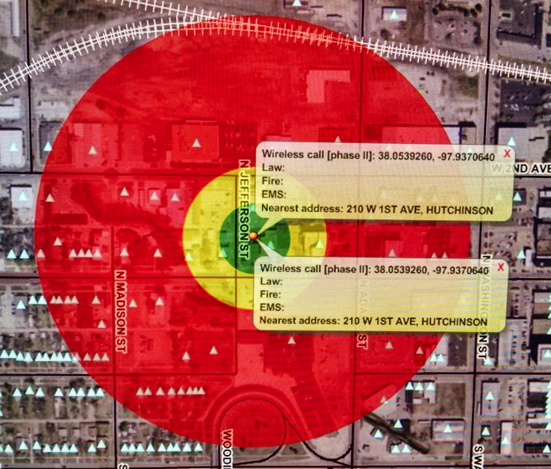

Slide 12
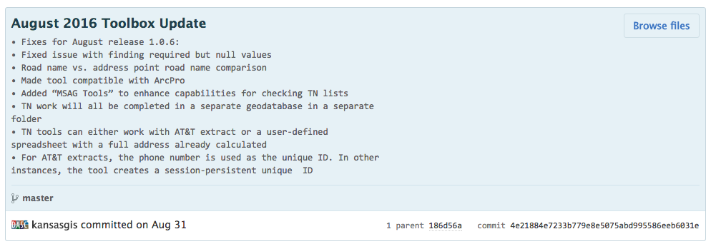
NG911 Toolbox
Monthly updates
Email updates will start coming from to Portal (portal@kansas911.org)
Official Change Log on GitHub
https://github.com/kansasgis/NG911/commits/master
Coming soon - October
MSAG comparison tool
Data Model v1.1 to v2.0 conversion tool

Slide 13
DASC NG911 webpage
http://www.kansasgis.org/initiatives/NG911
Kansas NG9-1-1 GIS Data Model v2.0
Kansas NG9-1-1 GIS Data Model Domains v2.0
Training announcements
Local GIS Data Steward and GIS Data Maintainer offered annually in all 6 regions
On-line “continuing ed” training
Imagery
GIS Committee discussing NG911 Imagery refresh plans with 911 Council

Slide 14
NG911 GIS Committee
Chair
Ken Nelson
NG911 Liaison
Scott Ekberg
KU DASC
Eileen Battles
NG911 Program Mgr
Randall White
Ellis County
Eamonn Coveney
KDOT
Kyle Gonterwitz
Riley Co
Sherri Taylor
Sedgwick Co
John Rogers
Johnson Co
Keith Shaw
Johnson Co
Mark Whelan
MARC
Saralyn Hayes
Co-Chair
Sherry Massey

